Slide 1

How to blend together a professional? Engaging students in their professional development via practice management
Anneka Ferguson,
ANU Legal Workshop
Australia

Slide 2
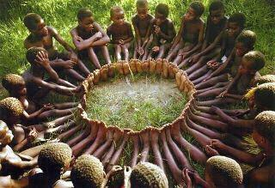
Professional Practice Core- at a glance
18 week – online – across 7 jurisdictions – approx. 500 students/two iterations a year
Integrates Civil litigation, Commercial litigation, Property, Trust Accounting, Ethics and Practice Management into single course
“In role” learning– students are a group of 4 junior lawyer- within a firm; transactional; simulated practice; and
Out of role learning (individual, more traditional resources and assessment)

Slide 3

Teacher roles redefined:
Convenors (6)of each practice area - responsible for overall simulated scenario, resource creation, management of practitioner teachers
Practitioner teachers - Mentor in content areas as ‘in role’ Senior partners, Associates and clients within the Virtual Office Space
Using feedback and feed-forward to develop competency rather than ‘give grades’
Practice mentors – mentor professionalism, groupwork and file management skills

Slide 4
PPC Week | Start Date | PM | Property | Ethics | Commercial | Civil
1 | 9 July
2 | 16 July
3 | 23 July
4 | 30 July
5 | 6 Aug
6 | 13 Aug
7 | 20 Aug
8 | 27 Aug
9 | 3 Sept
10 | 10 Sept
11 | 17 Sept
12 | 24 Sept
13 | 1 Oct
14 | 8 Oct
15 | 15 Oct
16 | 22 Oct
17 | 29 Oct
18 | 5 Nov

Slide 5
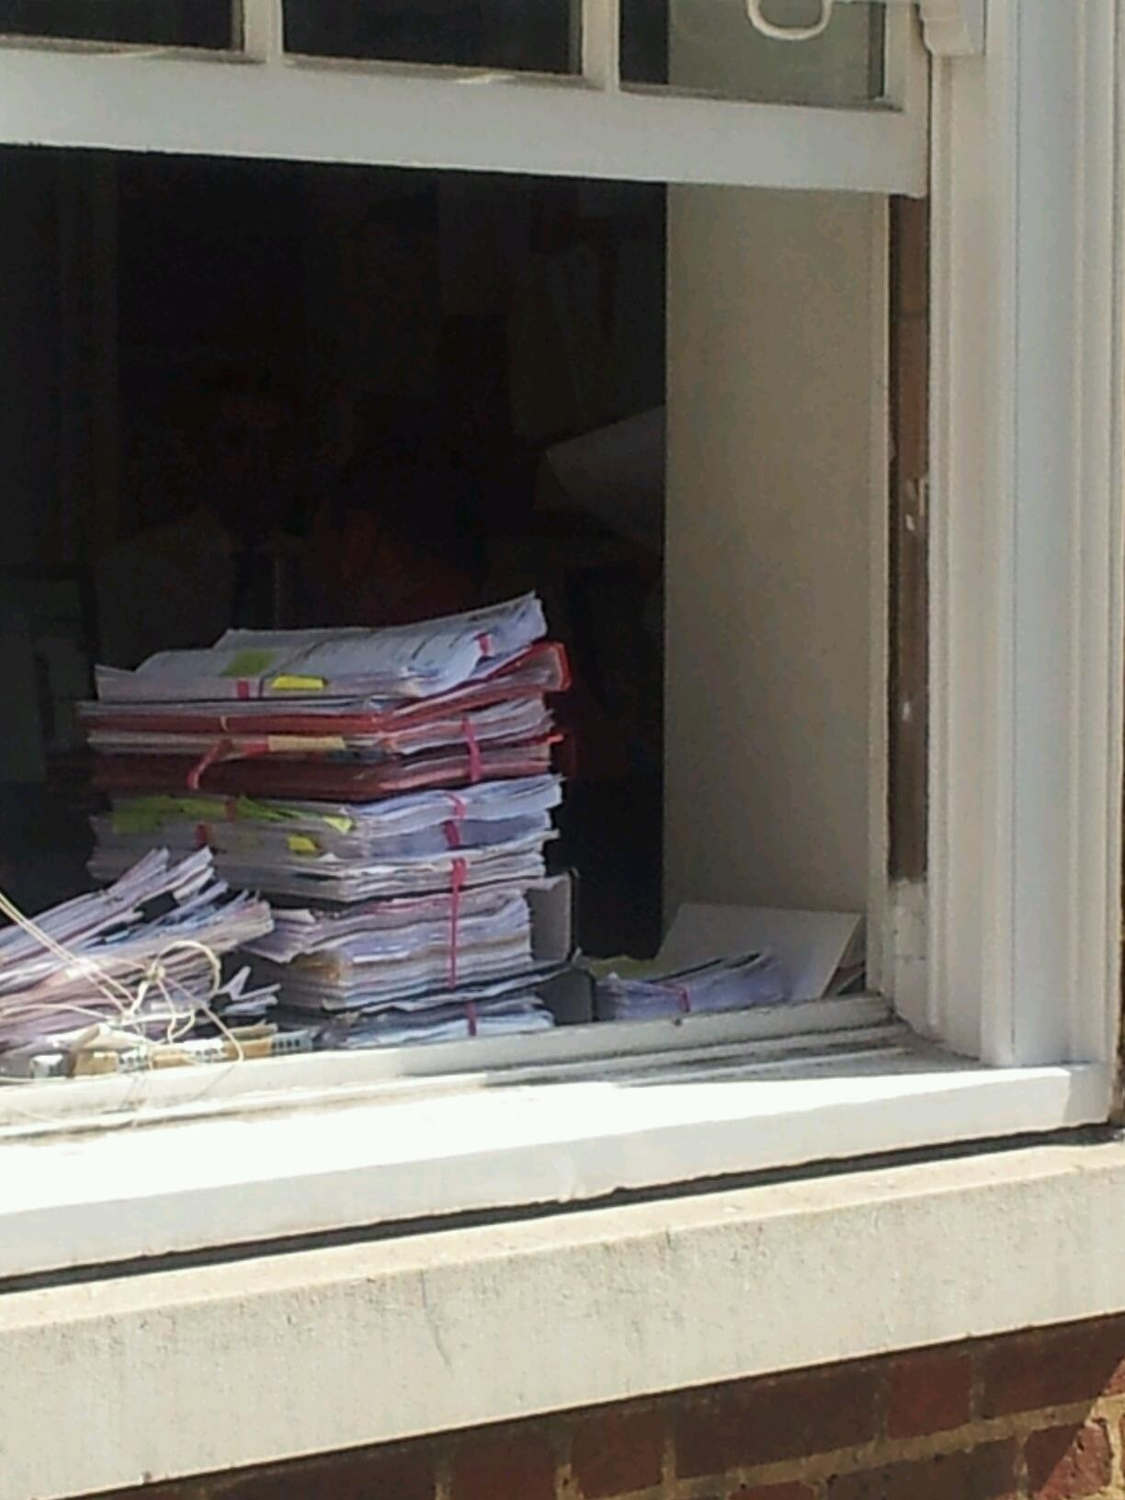
Overview of Practice Management
Areas to be covered
Practice Management Skills such as File and Time Management
Managing Group dynamics
Development of Professional Identity and Integrity
Individual wellbeing
Underpinning methodologies/concepts
Giving Voice to Values
Uncertainties of Practice
Legal Professional Obligations
Outputs/’Assessment’
Successful group work in Virtual Office Space
3 (at least) Professional Development Journal Entries
4 Web conferences with your firm and practice mentor
Weekly Workplan and Activity Logs

Slide 6
Survey as part of Orientation
My style of working
When you start tasks
How you deal with conflict
Communication styles
Loyalties
Experience of values conflicts
Responses to values conflicts
Views on professionalism

Slide 7
First Webconference
Introduction – group conflict scenarios
  Example: You (Case Manager) finally get some work through from your team members to review. Looking at the work, you suspect that they have copied and pasted the information from somewhere else, as it is all fragmented. It could be copied from their own university notes, but you don’t know.
  What do you do?

Slide 8
First Professional Development Journal
“Tale of Two Stories”
Emphasis by practice mentors on constructive feedback that elicits deeper reflection on the methods student uses to address values.

Slide 9
Second Professional Development Journal and webconference
Uncertainties of practice and a journal of things I am uncertain of
Why keeping the trains running on time – i.e. file management, prioritisation, good timely and courteous communication- assists you to deal with the uncertainties of practice

Slide 10
Third Webconference and Journal
The exercise we are working on…
Drawing on values and knowledge of how you respond to conflict without irrational reasons and rationalisations and an understanding of your environment and purpose to… construct a script and practice “Voicing your Values”

Slide 11
Fourth Webconference
Voicing Values in relation to your own and someone else’s wellbeing.

