Slide 1
A Schulichian Show and Tell
(including Collaborative Teaching as Interpretive Dance)
Jocelyn Downie
and
Richard Devlin
Dalhousie University
Schulich School of Law
NIFTEP WORKSHOP
Banff
July 2012

Slide 2
Course Objectives

Slide 3
This course is intended to develop students’:
awareness of and ability to identify and resolve ethical problems in a legal context
awareness of the need for cultural and emotional competence in the practice of law
understanding of the legal and ethical duties and responsibilities of lawyers and the legal profession
understanding of the different possible roles for lawyers, the legal profession, and the legal system
knowledge of the relevant legislation, regulations, rules of professional conduct and common or case law
knowledge of legal and quasi-legal responses to unethical conduct and professional incompetence
ability to make informed and reasoned contributions to the development of the legal profession and legal system

Slide 4
Upon successful completion of the course, it is hoped that students will be able to:
make informed and reasoned decisions when they are confronted with ethical dilemmas during law school
make informed and reasoned decisions about what kinds of lawyers they want to be (if any) and how they want to use their law degrees (if at all)
meet Law Society legal ethics and professional responsibility requirements
make informed and reasoned decisions when they are confronted with ethical issues after graduation
act in a professionally and ethically appropriate manner
make informed and reasoned contributions to the development of the legal profession and legal system
clearly express and defend positions on a range of issues in legal ethics and professional responsibility
conduct a respectful discussion of controversial legal ethics and professional responsibility issues with individuals holding contrary views

Slide 5
Heuristics

Slide 6
A LAWYER'S WEB OF RELATIONSHIPS
Client
Client
Lawyer
Client
Client

Slide 7
A LAWYER'S WEB OF RELATIONSHIPS
Partners, associates, staff
Business Partners
Client
Courts
The Law Society
Client
Client
Lawyer
Society
Third parties
Family
Client

Slide 8
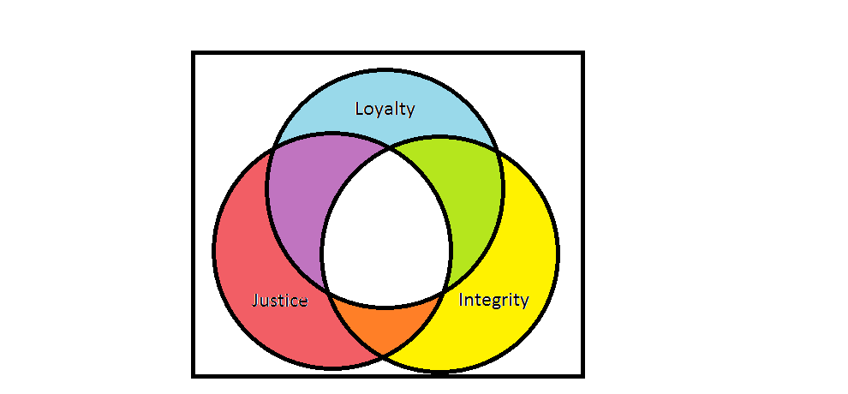
Values Venn Diagram

Slide 9
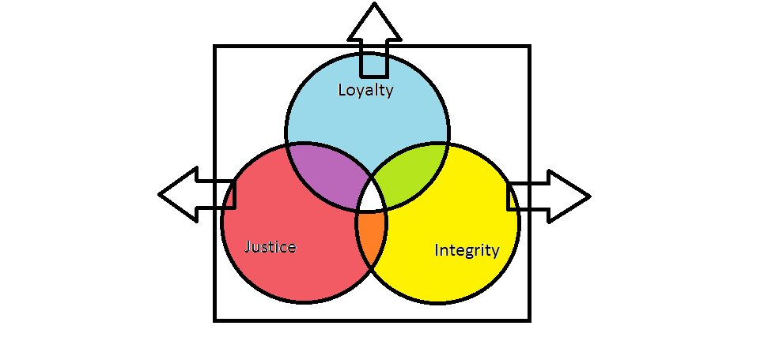

Slide 10
Framework for Ethical Analysis

Slide 11
  Get the facts
  Investigate the governing “rules”
  - Act
  - Regulations
  - case law
    - Codes of Ethics
  - disciplinary decisions of Bar Societies
  3) Reflect on the underlying spirit and philosophy of the “rules”
  - theories, principles, norms, values, virtues
  4) Ascertain the client’s interests, wishes, rights, and obligations (where there is a client involved)
  5) Reflect on the interests of other affected parties
  6) Reflect on one’s duties (to the public, the court, the profession, colleagues, one’s family)
  7) Identify one’s own personal theories, principles, norms, values, and virtues that are implicated in the situation
    family, culture, community, religion
    philosophy

Slide 12
  8) Identify the choices available
  9) Assess the possible consequences of each of the choices
    - probability and nature (severity) or possible harms and benefits
  10) Identify the constraints on particular choices
    - e.g., illegal, contrary to Code of Ethics, contrary to personal ethics
  11) Discuss with others
  - more senior colleagues
  - Bar Society
  - external ethics experts
  12) Engage in self-reflection
  13) Identify priorities
  14) Choose and implement a course of action/inaction
  15) Review choice
  - the result
  - the processes
  - the need for change (personal, professional, institutional)

Slide 13
Collaborative Teaching

Slide 14
Interpretive Dance

Slide 15
INTRODUCTION
FORMATION
A) ADVERTISING
B) SOLICITATION
C) CHOICE OF CLIENT
TERMINATION
A) WITHDRAWAL DURING A MATTER
MANDATORY
OPTIONAL
COURT APPROVAL OF WITHDRAWAL
B) FORMAL TERMINATION AFTER CONCLUSION OF MATTER

Slide 16
1. How does the lawyer-client relationship balance the three values of integrity, loyalty and justice?
2. How do we calibrate our obligations to individual clients with our obligations to the profession, the courts, other lawyers and society?
3. How do we mediate between the traditional view of lawyering as a “profession” and the more modern view of lawyering as a “business”?
4. How do we balance the pursuit of our public duties as lawyers with our own private – financial/ideological – preferences?

Slide 17
Advertising
Objections to advertising
  Traditional
    Reputation management/Victorian snobbery
    Limit competition
    Unnecessary
  Contemporary
    Encourage self-aggrandizement at expense of truth
    Arouse unattainable expectations of clients
    Increase costs of legal services for clients
    Reinforce concentration of legal services in large firms

Slide 18
Advertising
Reasons for allowing advertising
  Access to justice
  Informed client choice
  Freedom of expression for commercial speech
  Competition
Rules re: advertising
  Allowed with limits

Slide 19


Slide 20

Our Lawyers Rock
mess with us and we'll bury you under a landslide of paper. very expensive paper. then we'll light it on fire and dance in the ashes. naked.
Your Lawyers Stink
sadly, there are no lawyers in the world that can save your sorry butt. its not your fault, we got to ours before you and they're better... as we've already said.
innovation. clarity. function
.

Slide 21
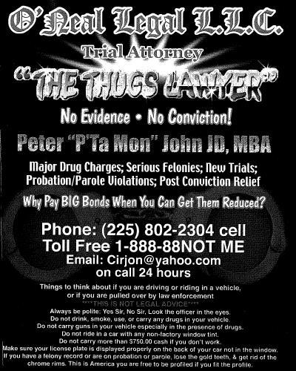

Slide 22
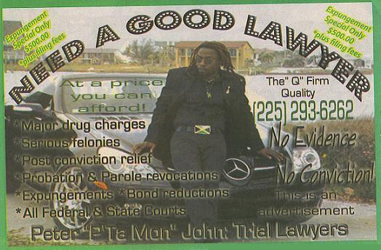

Slide 23
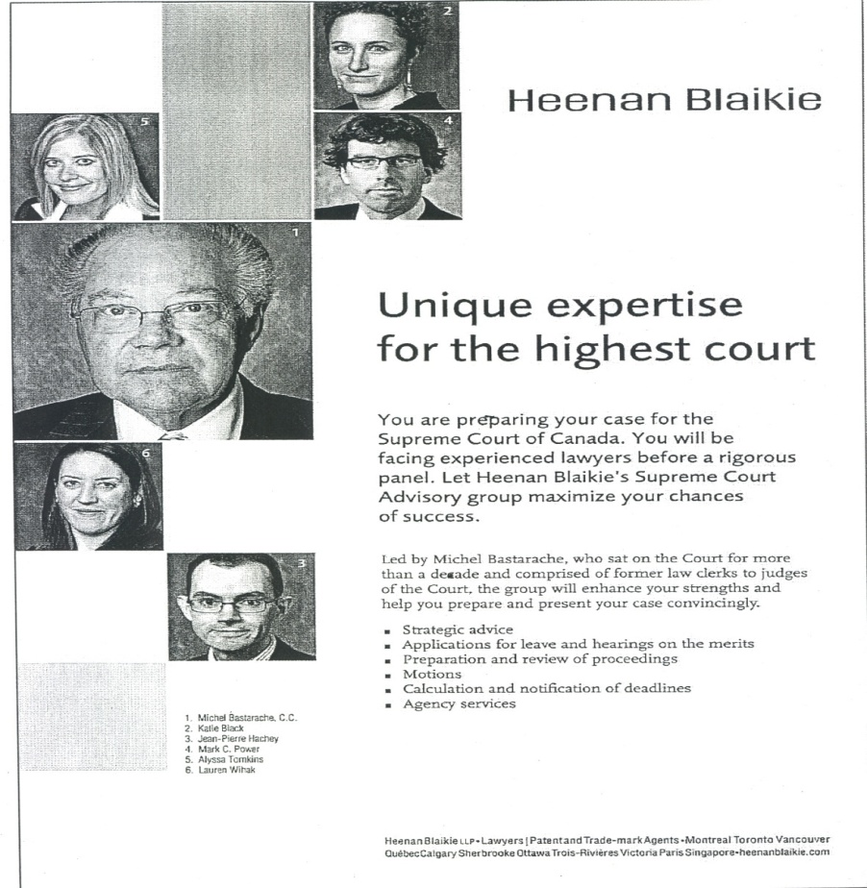

Slide 24

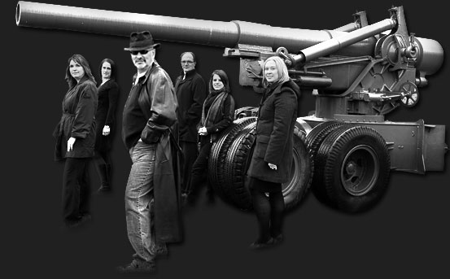
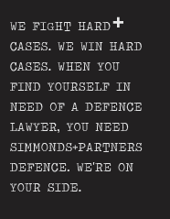
Skip to content
ABOUT
WHO WE ARE
WHAT WE DO
RESOURCES
BLOG
CONTACT

Slide 25
INTRODUCTION
FORMATION
A) ADVERTISING
B) SOLICITATION
C) CHOICE OF CLIENT
TERMINATION
A) WITHDRAWAL DURING A MATTER
MANDATORY
OPTIONAL
COURT APPROVAL OF WITHDRAWAL
B) FORMAL TERMINATION AFTER CONCLUSION OF MATTER

Slide 26
Questions and Discussion

Slide 27
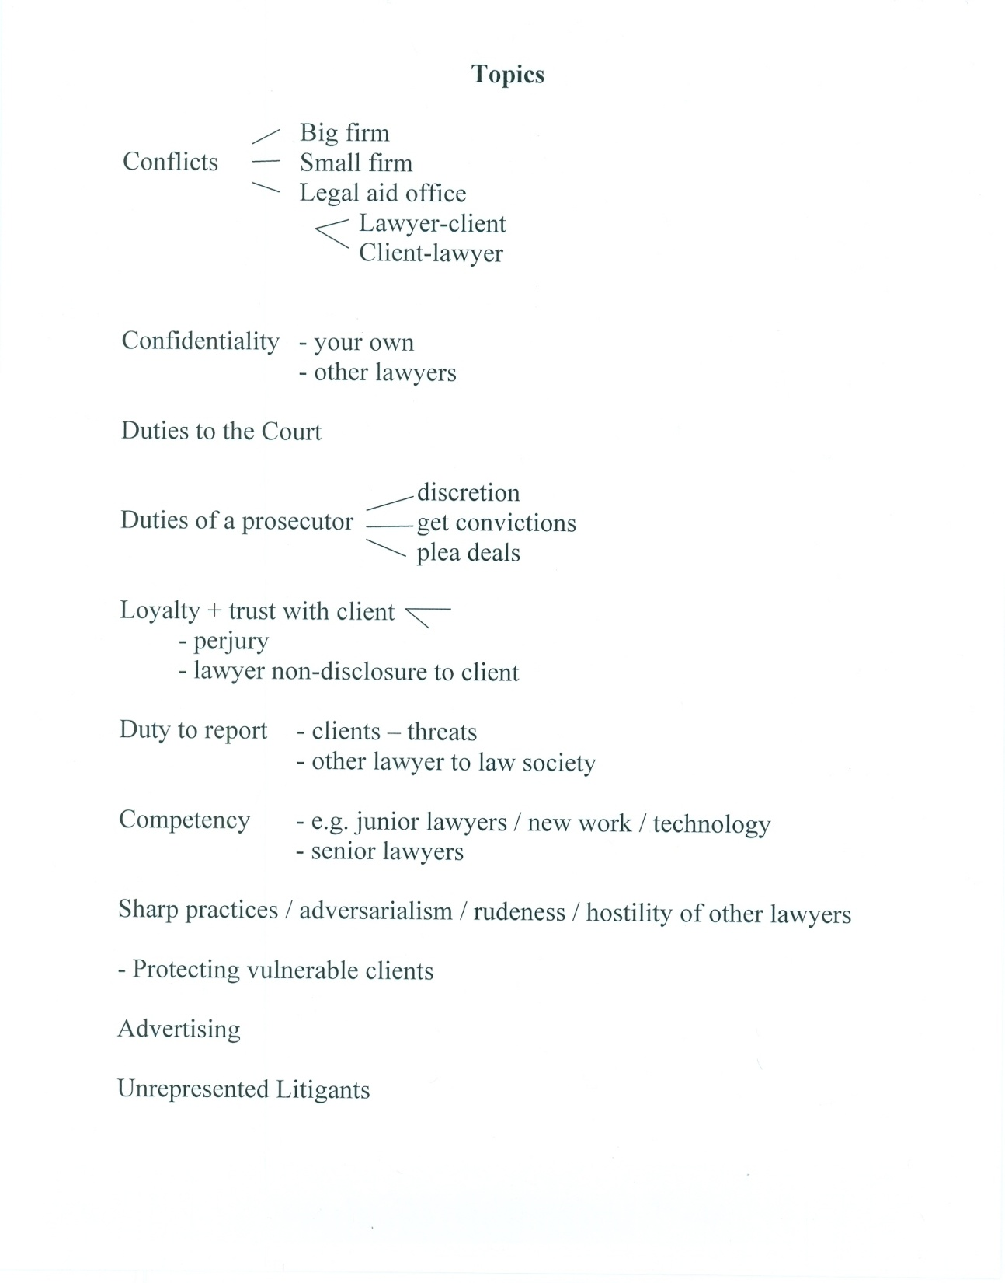

Slide 28
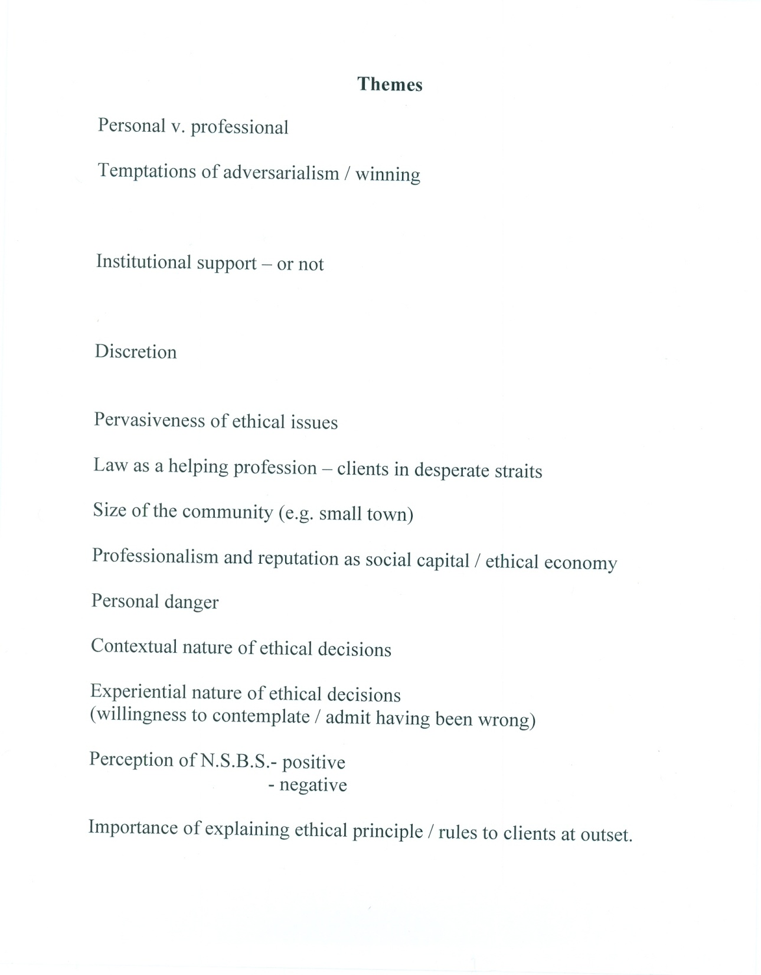

Slide 29
