Slide 1


Why do we teach Legal Ethics?
Juan P. Beca
Based on Karol Muñoz and Claudia Valenzuela’s work
London, july 2014

Slide 2



Is it required?
Título de la diapositiva
Not in civil law tradition
Private good vs Common Good

Slide 3

Título de la diapositiva
Ethics & Moral
Ethics is for self improvement
Leads to action
MORAL
REFLECTION
ETHICS

Slide 4
Ethics & Deontology
Título de la diapositiva
Ethics is about good itself
Looks to individual conscience
Deontology is about duties
Looks at social shared criteria
Ethics implies reflection
Without ethics deontology is not valuable. Not possible to reach collective reasoning without individuals’ ideas of good.

Slide 5

The profession as a mission (Cortina)
Título de la diapositiva
The professional (lawyer) has a mission
Collective mission
The profession do good to society. Is a public service
Corporate spirit
Self regulation and right of association
Deregulation
How to foster reflection and willingness to be self regulated?

Slide 6

Stages of moral development
Título de la diapositiva
ETHICS
Kohlberg’s stage VI The Prophet/Messiah. Looks at universal principles
Rawls’ veil of ignorance
Gilligan’s postconventional stage. Care for self and others
Kohlberg’s stage V The Philosopher/King. Asks what a society ought to be.
Kohlberg’s stage IV: The Good Citizen, thinks of society widely.
DEONTOLOGY

Slide 7

Quality teaching includes developing values
Título de la diapositiva
We model our students (Lerman)
We can’t be neutral on values issues.
Duty of all faculty members
Ethics and clinics

Slide 8
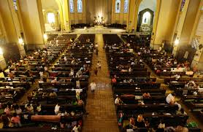
Why students are reluctant to learn ethics?
Título de la diapositiva
Being a lawyer is dealing with moral choices and ethical dilemmas. (Gee & Elkins)
Clients not necessarily expect an ethical behaviour
The problem is the approach or the methodology?

Slide 9
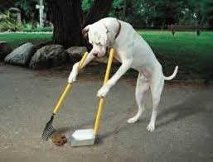
Teaching & learning
Título de la diapositiva
A course in the curriculum will ensure we teach.
Ethics courses should not only be theoretical neither only practical.
Students should learn to reflect on their own dilemmas.

Slide 10
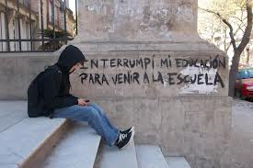

Single course or transversal?
Título de la diapositiva
Pros & cons
If we seek to provide ethical knowledge: Many courses with conceptual, procedural and attitudinal contents.
Curriculum should be consistent with what is really taught
Our duty is not only to educate good professionals but also good citizens
Being a scholar is not only about producing and transmitting science, but also a responsible action and ethical commitment with that knowledge

Slide 11
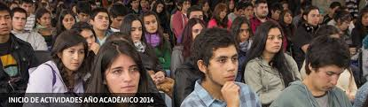
Título de la diapositiva
If providing ethical knowledge is declared it should be addressed in the curriculum.
If it’s not?: Ethics go beyond obligations

Slide 12


Título de la diapositiva
Compare views of students at two Law Schools in Temuco
Ethics is considered in the mission statement.
There is not an ethics course
Teachers are instructed to consider ethical issues in their classes
Ethics is considered in the mission statement.
There is an ethics course
The competency is considered in different courses
Same goal. Different way to achieve it

Slide 13
Título de la diapositiva
Knowledge of the Colegio de Abogados
.

Slide 14
Título de la diapositiva
Knowledge of the Code of Conduct
.

Slide 15
Título de la diapositiva
Is the code mandatory for all lawyers?
.

Slide 16
Título de la diapositiva
Does the code establish guidelines for lawyers?
.

Slide 17
Título de la diapositiva
Do you consider the possibility of affiliating to the Colegio de Abogados?
.

Slide 18

What does a specific course give?
Título de la diapositiva
Certainty
Willingness to be self regulated
Not necessarily more conceptual knowledge
Increases attitude knowledge

Slide 19

Conclusions
Título de la diapositiva
We teach legal ethics because we need to do it.
Students get technical knowledge and values
A specific course enhances responsibility. But is not enough
A transversal approach is needed

Slide 20
Thanks for your attention
London, july 2014

