Slide 1
Outcomes Assessment and Course Design
Barbara Glesner Fines
Associate Dean for Faculty Development
Rubey M. Hulen Professor of Law
UMKC

Slide 2
Topics for discussion in this session
What learning goals can we realistically expect from a professionalism curriculum or program?
Are we able to translate those goals into concrete, specific, and significant learning outcomes?
What tools for assessing learning of those outcomes would drive curricular improvement?

Slide 3
Current assessment practice in american Law schools

Slide 4


Slide 5
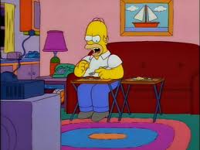
I told you last night, No!

Slide 6
A review of some basics

Slide 7
The power of assessment of student learning
Assessment drives learning
Assessment improves teaching
Assessment is not testing
Assessment is not grading
Notes:
A little bit about what I bring to this equation. I have devoted a portion of my career to studying legal education. For the past ten years, I have been a member of various task forces at our University devoted to assessment of student learning. Assessment is a critical part of the accreditation of Universities and our particular university had not devoted the resources and attention to assessment required by the standards of the North Central Association of Colleges and School’s Higher Learning Commission. Similarly SUNY is accredited by the Middle States Commission on Higher Education. For years, professional schools were not required to participate in their University’s accreditation plans, because the thought was that licensure exams provided the accountability function of assessment; however, in recent years understanding of the purposes of assessment go beyond mere accountability and law schools are increasingly being called upon to show that they are assessing student learning and continually working to provide value-added to students enrolled in their institutions. Assessment has a powerful influence on learning. It can drive learning when properly used. It can improve teaching as well. But it must be understood as something other than grades on tests, but as an overall process.

Slide 8
Outcomes Assessment is
  Knowing where you want your students to be
  Knowing where your students are
  If they aren’t where you want them, figuring out how to get them there

Slide 9

The Most Common Approach To Choosing Outcomes

Slide 10
Coverage is Overrated
We can’t cover it all
More coverage results in less learning

Slide 11
Assessments
Final projects/ papers
Service Learning
Drafting
Quiz/ Midterm
Simulations
Final Exam
Performance
Tests
Student participation & dialogue
Peer & Self Assessment
Models
Observation
Rubrics
Reflection papers
Individual conferences
Small group discussions
Notes:
Formative assessments
Pre-tests and worksheets before class
CALI lessons assigned
Socratic dialogue in class
Drafting assignment
Self and peer assessments based on rubrics or models
Minute papers or reflection papers
Summative assessment
Key to assessment : both you and the students know what they are learning well and what they are learning poorly so you each can adjust your teaching and learning

Slide 12
Assessments
Final projects/ papers
Drafting
Service Learning
Quiz/ Midterm
Simulations
Final Exam
Performance
Tests
Student participation & dialogue
Observations & Perceptions
Peer & Self Assessments
Models
Rubrics
Reflection papers
Individual conferences
Small group discussions
Notes:
Formative assessments
Pre-tests and worksheets before class
CALI lessons assigned
Socratic dialogue in class
Drafting assignment
Self and peer assessments based on rubrics or models
Minute papers or reflection papers
Summative assessment
Key to assessment : both you and the students know what they are learning well and what they are learning poorly so you each can adjust your teaching and learning

Slide 13
Goals of the Law School Curriculum
What do our students want to be able to know, do or believe?
What do the licensing authorities want our students to be able to know, do or believe?
What do our students’ employers want our students be able to know, do or believe?
What do members of the public want our students be able to know, do or believe?

Slide 14
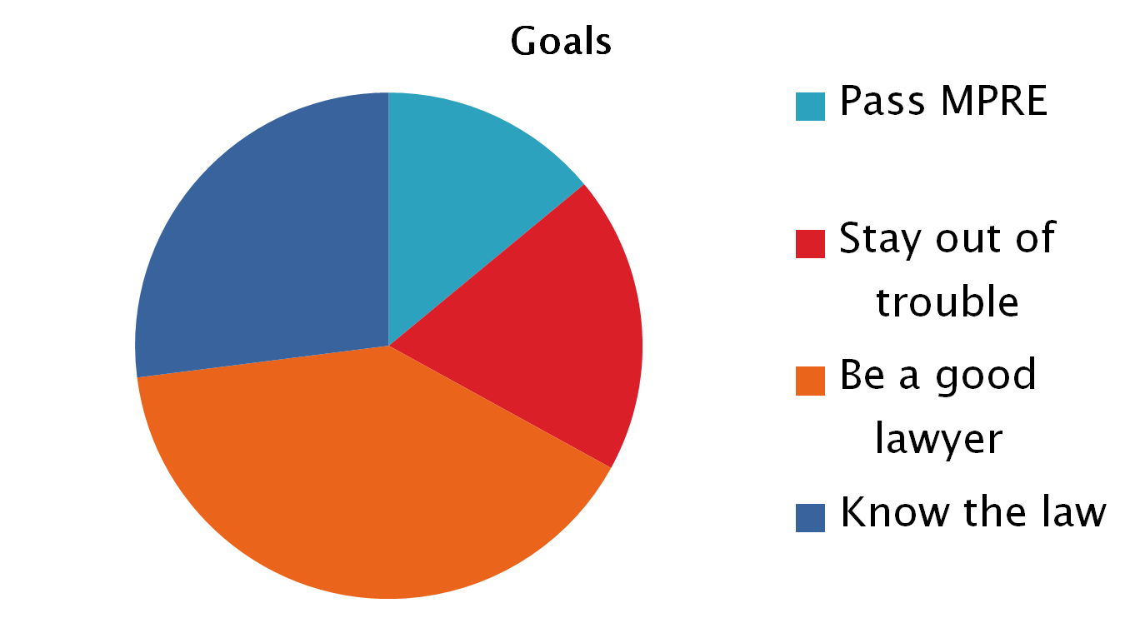
What are the student goals?

Slide 15
What are the goals of licensing authorities?
You can’t expect what you can’t inspect.
What are the apparent learning outcomes being assessed by the bar admission process?
  By Character and Fitness screening?
  By the MPRE?
  Other admissions assessments?

Slide 16
Employers and Professionalism
Ability to take direction and admit ignorance
Ability to research and read not “mine” the law
Ability to work with others (including clients)
Ability to manage time, information and technology

Slide 17
What does the public want?
Affordable access to legal processes
Attorneys they can trust

Slide 18
What can we realistically do?

