Slide 1

Legal Clinic – A Transformative Experience?
Jana Hoffmannová, Luděk Šebek
Veronika Tomoszková, Maxim Tomoszek

Slide 2
Overview
Structure
Why?
Who?
How?
Outcomes, observations
Fun

Slide 3


Jana and Luděk

Slide 4
CLE Programme at Palacký Law
One semester (13 weeks = 09 – 12, 02 - 05), after that exams period
Beginning of the semester: selection procedure + orientation events to get students ready:
Organizational Workshop in the office
Skills Training Workshop (over weekend in a holiday resort)
In semester: intake interviews only until we fill up case capacity, then client interviews, work on cases, counselling
Students keep working on cases also during exams period

Slide 5
Live-Client Clinics at Palacký Law
GENERAL
Student Legal Aid Clinic
CONSUMER
Consumer Law Clinic
ADMIN
Administrative Law Clinic
BUSINESS
"Business and Law" Clinic

Slide 6
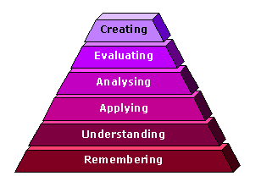
Bloom‘s taxonomy of learning objectives
Schemes come from http://www.learningandteaching.info/learning/bloomtax.htm
Bloom modified by Anderson and Krathwohl (2001) – cognitive

Slide 7
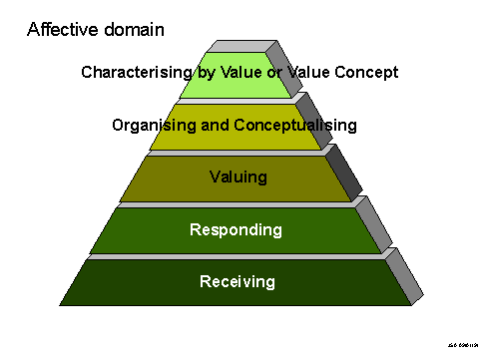
Bloom‘s taxonomy - continued
Affective – Kratwohl, Bloom and Masia (1964)

Slide 8
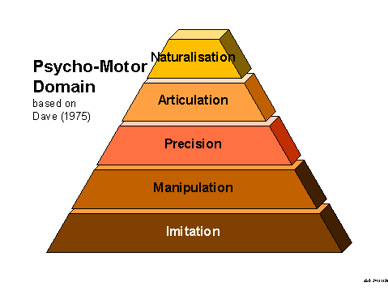
Bloom‘s taxonomy - continued
Skills – Dave (1975)

Slide 9
What is the transformative effect of clinic?
Effect of clinical experience -> personal development of students (self-awareness) -> transformation
To some extent connected with Bloom‘s taxonomy – moving to higher-level learning objectives
Applies to knowledge, skills and values; transformation is complex, with probably most important part in values (?)
knowledge – deeper understanding, application, creativity
skills – precision, adaptation, naturalization, professionalism
values – responding, valuing, conceptualizing
Students are different as a result – different thinking, different values
How do we measure this?

Slide 10
Test battery - composition
Research questions:
What is the effect of LCCs at Palacký Law on students‘ personal identity?
Does the clinical experience have transformative effect?
What factors influence the transformative effect?
Quantitative (online)
GSE questionnaire (self-efficacy) – modified for LCC
Life satisfaction questionnaire
Stress-management strategy questionnaire
Qualitative
Life-line
H-Form
Focus group

Slide 11
Research Plan
Selection process (applications, interviews) – well-being question
3 online questionnaires (before and after)
Weekend workshop – expectations, reflection on questionnaires
Case reports – reflection of vaules
Towards the end of semester
Life Line
Research Session 1 to reflect and generate ideas – H-Form
Research Session 2 – focus groups

Slide 12
Modified self-efficacy
Based on General Self-Efficacy
http://userpage.fu-berlin.de/health/selfscal.htm
4 steps scale (agree – partially agree – partially disagree – disagree)
Modified for LCCs:
I can work with difficult clients
I can communicate contructively in difficult situations
I can work with difficult supervisor
I can improve my ability to help clients
I can overcome disturbing influences
I can react to client‘s needs even on my bad days
I can help client to be better oriented in legal and personal aspects of their situation
I can creatively solve difficult legal problems
I can motivate people around me for teamwork
I can persuade my supervisor about the value of my solution

Slide 13
Life Satisfaction Questionnaire
Life Satisfaction Questionaire (Fahrenberg, Myrtek, Schumacher & Brähler 2000), in original Fragebogen zur Lebenszufriedenheit (FLZ)
reconstructed and standardized on the basis of a 1994 survey of 2,870 residents (aged 14-92 years old) of the old and new German states (i.e., former West and East Germany, respectively).
Used for Palacký students in general
With a total of 70 items, the LSQ measures individual satisfaction in 10 areas of life: (1) health, (2) work and career, (3) financial situation, (4) recreation, (5) marriage and partnership, (6) relationship with own children, (7) own self, (8) sexuality, (9) friends, acquaintances, relatives, (10) housing.
This standardized questionnaire makes it possible to capture individual satisfaction in 10 areas of life and then compare these with representative population norms.

Slide 14
Stress management
Stress coping factors
Based on Janke, Erdmann – SVF 78
Denial, Under-valuation, Diversion, Alternative satisfaction, Situation Control, Reaction Control, positive self-instruction, social support, avoidance, resignation, perseverance, self-blaming

Slide 15

Life-line Interview Method
Method to measure autobiographical memory
People draw their own life-line and tell their life story for both the past and future
Gives us insight into one person´s life experience, the way that it is interpreted and how it shapes that person´s behavior
Marian Assink & Johannes J.F. Schroots (2010)

Slide 16
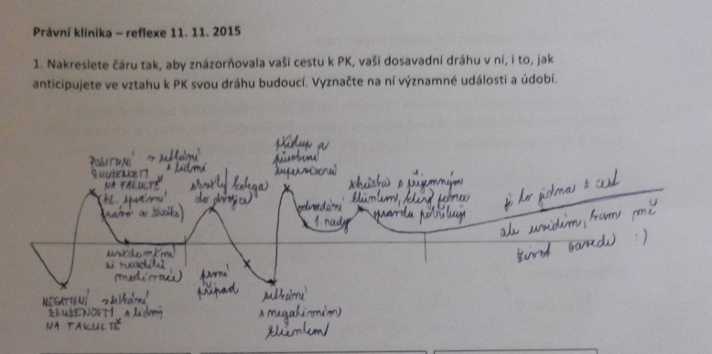
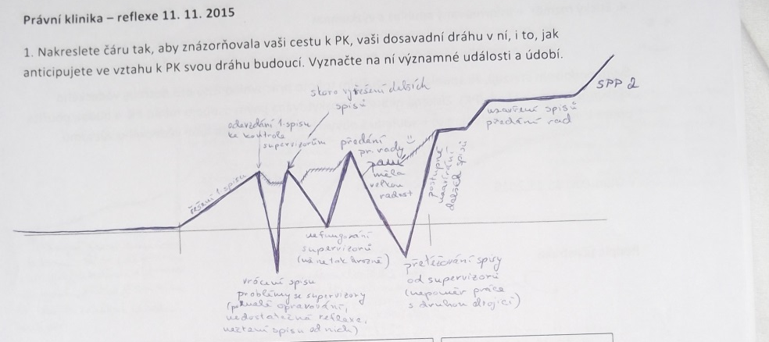
Sample responses

Slide 17
H-Form
Evaluation method that was developed along with a whole range of methods known as Participatory Appraisal (PA).
Comes from Susan Guy and Andrew Inglis (1999).
Visual, inclusive
Evaluates anything from a conference to an event to a training course.
Single question
The responses to the question come direct from participants’ experiences, and their answers highlight the things that are important for them.
Powerful and empowering, creates agenda for improvement

Slide 18
Focus Group
Group dynamics
Reacting to each other
Homogeneity of group
Identification of themes

Slide 19
Outcomes – quantitative
Self efficacy:
Moderate increase in self-efficacy
More progress in client-related skills
With some students – regress in supervisor related skills
Very low scores on team-work
Life satisfaction and Stress management – still in process

Slide 20
Outcomes - qualitative
Effects on students
practical experience - development of skills, professionalism
development of deeper understanding, reinforcement
average rate of achieving goals – 65 %; life-line going up
importance of helping people
Factors
supervisor, clients, workload, cases, stress, office, paperwork, partner
Future
continue in clinic
become a supervisor
profession

Slide 21
Outcomes - values
Hard for students to identify – they speak about justice, helping people
Lack of vocabulary
Limited by students‘ satisfaction by extent of client‘s cooperation
Confusing values with skills or knowledge
Underestimation of meaning of values
On level of receiving, responding, at best valuing
Limited outcomes, or perhaps limited realization/reflection of transformation -> role of supervisors
Need for directed development

Slide 22
Generalization – transformative experience
It does not come by itself, requires attention
Role of supervisor and management of the clinic
Explanation to students
Reflection

Slide 23
H-Form
How well do the students use the transformative potential of clinical legal education in your clinical programme?

Slide 24
Resources
Fahrenberg, J., Myrtek, M., Schumacher, J., & Brähler, E. (2000). Fragebogen zur Lebenszufriedenheit (FLZ). Handanweisung. Göttingen: Hogrefe
Stress coping questionnaire – article: http://www.activitas.org/index.php/nervosa/article/viewFile/109/155
The testing: http://www.testcentrum.com/testy/svf-78
Marian Assink & Johannes J.F. Schroots: The Dynamics of Autobiographical Memory Using the LIM Life-line Interview Method, Hogrefe Publishing, Gōttingen, Germany, 2010, 162 pp.
Bloom‘s taxonomy: http://www.learningandteaching.info/learning/bloomtax.htm
Inglis, A. S., Guy, S. Tips for trainers: Introducing the H-form – a method for monitoring and evaluation, online - http://www.evaluationservices.co.uk/files/HFormnotes.pdf
General self-efficacy: http://userpage.fu-berlin.de/health/selfscal.htm

Slide 25
Resources
Bloom taxonomy: http://teaching.uncc.edu/learning-resources/articles-books/best-practice/goals-objectives/blooms-educational-objectives
Bloom, B. S. Taxonomy of Educational Objectives Book 1: Cognitive Domain. 2nd edition. Addison Wesley, 1984
Krathwohl, D. R., Bloom, B. S., & Masia, B. B. (1964). Taxonomy of Educational Objectives: The classification of educational goals. Handbook II: Affective Domain. New York: McKay
Bloom Revised: http://www.unco.edu/cetl/sir/stating_outcome/documents/Krathwohl.pdf
Rudina Shkullaku: The Relationship between Self – efficacy and Academic Performance in the Context of Gender among Albanian Students - http://euacademic.org/UploadArticle/33.pdf
Teacher self-efficacy - http://www.strivetogether.org/sites/default/files/images/29%20Teacher%20Self-Efficacy%20Scale_bandura-instrument.pdf
Focus Group Guide: http://web.worldbank.org/archive/website01028/WEB/IMAGES/SDP_36.PDF

Slide 26
Resources – focus group
Guidelines for Conducting a Focus Group - https://assessment.trinity.duke.edu/documents/How_to_Conduct_a_Focus_Group.pdf
Krueger - Designing and Conducting Focus Group Interviews - http://www.eiu.edu/ihec/Krueger-FocusGroupInterviews.pdf
Kitzinger - The methodology of Focus Groups: the importance of interaction between research participants - https://www.sfu.ca/cmns/courses/2008/801/Fall2008/ClassFolders/Soerensen,%20Maria%20Odgaard/Kitzinger_The%20methodology%20of%20Focus%20Groups_the%20importance%20of%20interaction%20between%20research%20participiants.pdf

