Slide 1
Federal Preemption under Dodd-Frank’s Whistleblower Award Program
Kathleen Clark
Washington University in St Louis
6th International Legal Ethics Conference (ILEC-VI)
London
10 June 2014

Slide 2
Lawyer-Whistleblowers: Silence, Loyalty & Federal Financial Rewards Kathleen Clark & Nancy Moore

Slide 3
3
Federal
Whistleblower
Reward
Statutes

Slide 4
False Claims Act
Tax Relief & Health Care Act of 2006
Dodd-Frank Wall Street Reform and Consumer Protection Act of 2010

Slide 5
False Claims Act
Tax Relief & Health Care Act of 2006
Dodd-Frank Wall Street Reform and Consumer Protection Act of 2010

Slide 6
False Claims Act
Tax Relief & Health Care Act of 2006
Dodd-Frank Wall Street Reform and Consumer Protection Act of 2010

Slide 7
whistleblower
rewards
v.
protection

Slide 8
Dodd-Frank
- voluntarily provides
- original information
- successful enforcement action
- monetary sanctions > $1 million

Slide 9
Dodd-Frank
whistleblower
receives
10 – 30 %
of
sanctions

Slide 10
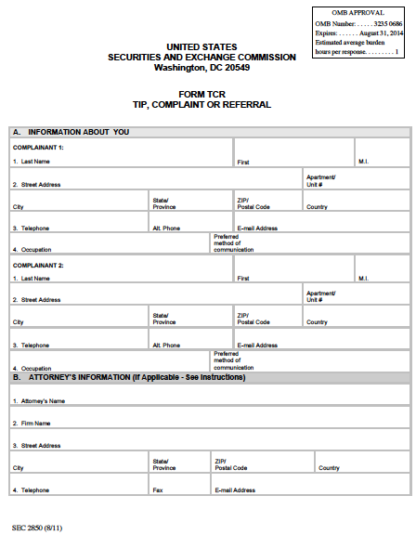

Slide 11
SEC sanctions > $ 1 million
“Notices of Covered Action”
90 days

Slide 12
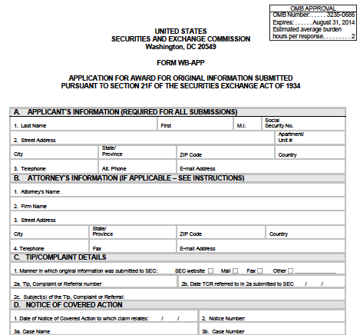

Slide 13
3000 tips / year

Slide 14
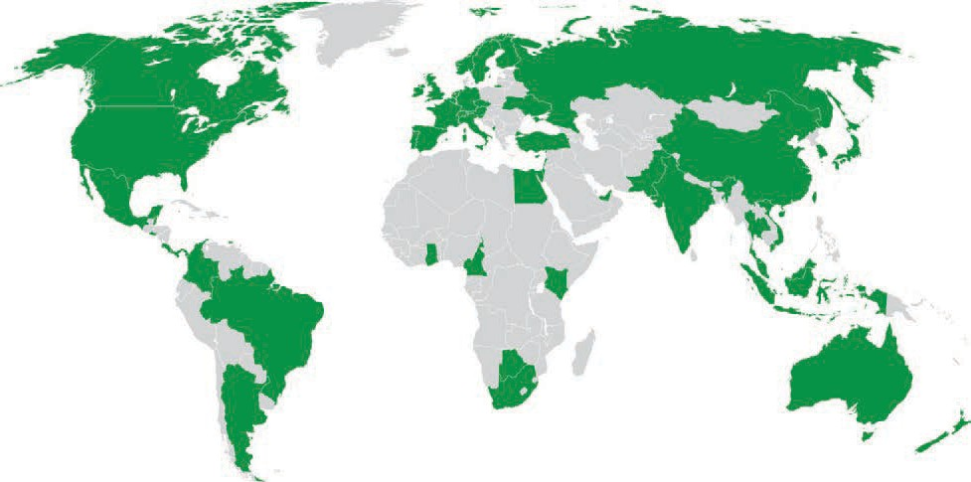

Slide 15
6 awards
largest: $14 million

Slide 16
Can lawyers
take advantage
of these
whistleblower awards
?

Slide 17
Dodd-Frank
statutory
silence
re:
lawyers

Slide 18
Dodd-Frank
SEC
regulations
re:
lawyers

Slide 19
Dodd-Frank SEC regs
Can’t use information:
-subject to A-C privilege or
-gained thru legal representation
. . . unless . . .

Slide 20
Dodd-Frank SEC regs
. . . unless permitted by:
- applicable state professional rules
- SEC SOX regulation
- “otherwise”

Slide 21
Professional Rules
confidentiality exceptions
for client fraud
vary
state-to-state

Slide 22
SOX regulation
disclose to:
prevent material violations
rectify consequences of material violation – if lawyer’s services were used

Slide 23
SOX regulation
confidentiality exceptions
broader
than
most states

Slide 24
SOX regulation
asserts
federal
preemption

Slide 25
Supremacy Clause
laws of the United States made in pursuance of Constitution shall be supreme law of the land

Slide 26
Preemption
Has
Congress
exercised
this
power?

Slide 27
express
preemption

Slide 28
implied
preemption

Slide 29
regulation
expressly
asserts
preemption

Slide 30
implied
preemption

Slide 31
obstacle
or
frustration
preemption

Slide 32
§ 307 of Sarbanes Oxley Act
required SEC
to issue rules
minimum standards of professional conduct for attorneys
including
internal whistleblowing

Slide 33
§ 307 of Sarbanes Oxley Act
required SEC
to issue rules
minimum standards of professional conduct for attorneys
including
internal whistleblowing

Slide 34
SOX regulation
requires internal whistleblowing
created additional confidentiality exceptions

Slide 35
SOX regulation
asserts
conflict
preemption

Slide 36
SOX regulation
resistance from
Washington state
&
California

Slide 37
SOX regulation
applies to lawyers who
“appear or practice”
before SEC

Slide 38
“appear or practice”
communicate
with
SEC

Slide 39
SOX regulation
applies to lawyers who
blow the whistle
to the SEC
under Dodd-Frank

Slide 40
SOX regulation
displaces
more restrictive
state
confidentiality rules

Slide 41
SOX regulation
does not displace
state rules
on other issues

Slide 42
adequately inform client
MR 1.4
conflicts of interest
MR 1.7(a)(2)
MR 1.8(a)

Slide 43
obligations to
current
v.
former
clients

Slide 44
Dodd-Frank
protects
confidentiality of
whistleblower’s
identity

Slide 45
Federal Preemption under Dodd-Frank’s Whistleblower Award Program
Kathleen Clark
ClarkEthicsConsulting@gmail.com
6th International Legal Ethics Conference (ILEC-VI)
London
10 June 2014

