Slide 1

A future for legal education: professional development and ethics
Nigel Duncan
Professor of Legal Education
The Value of Legal Education Conference

Slide 2

Knowledge of Professional Codes
Keeps about as well as fish

Slide 3
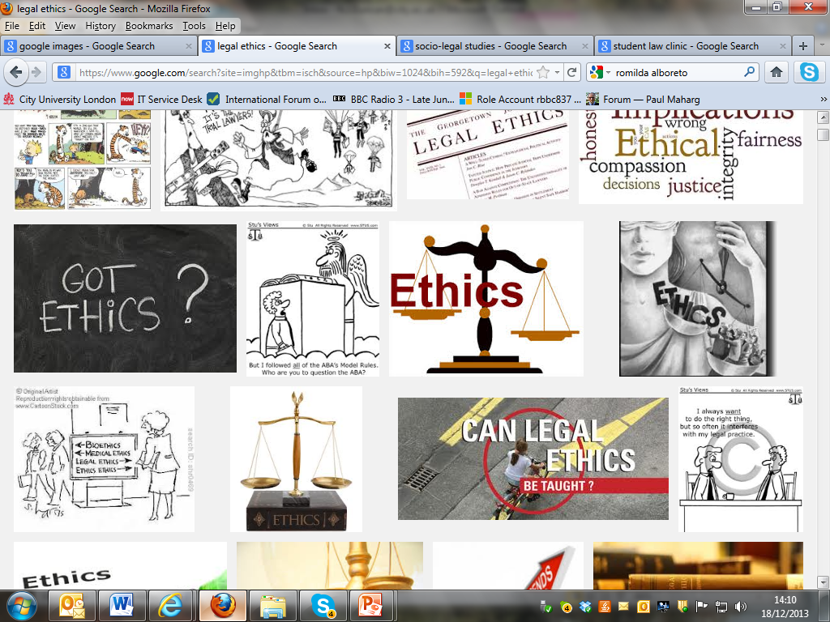

Slide 4
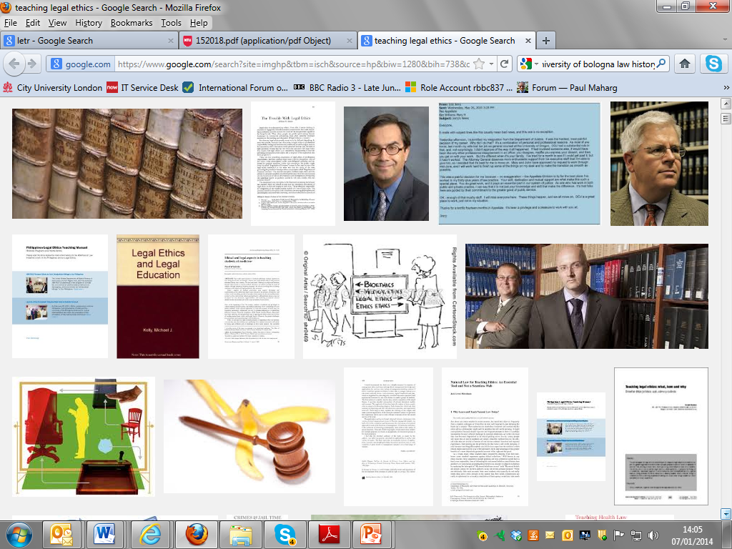

Slide 5
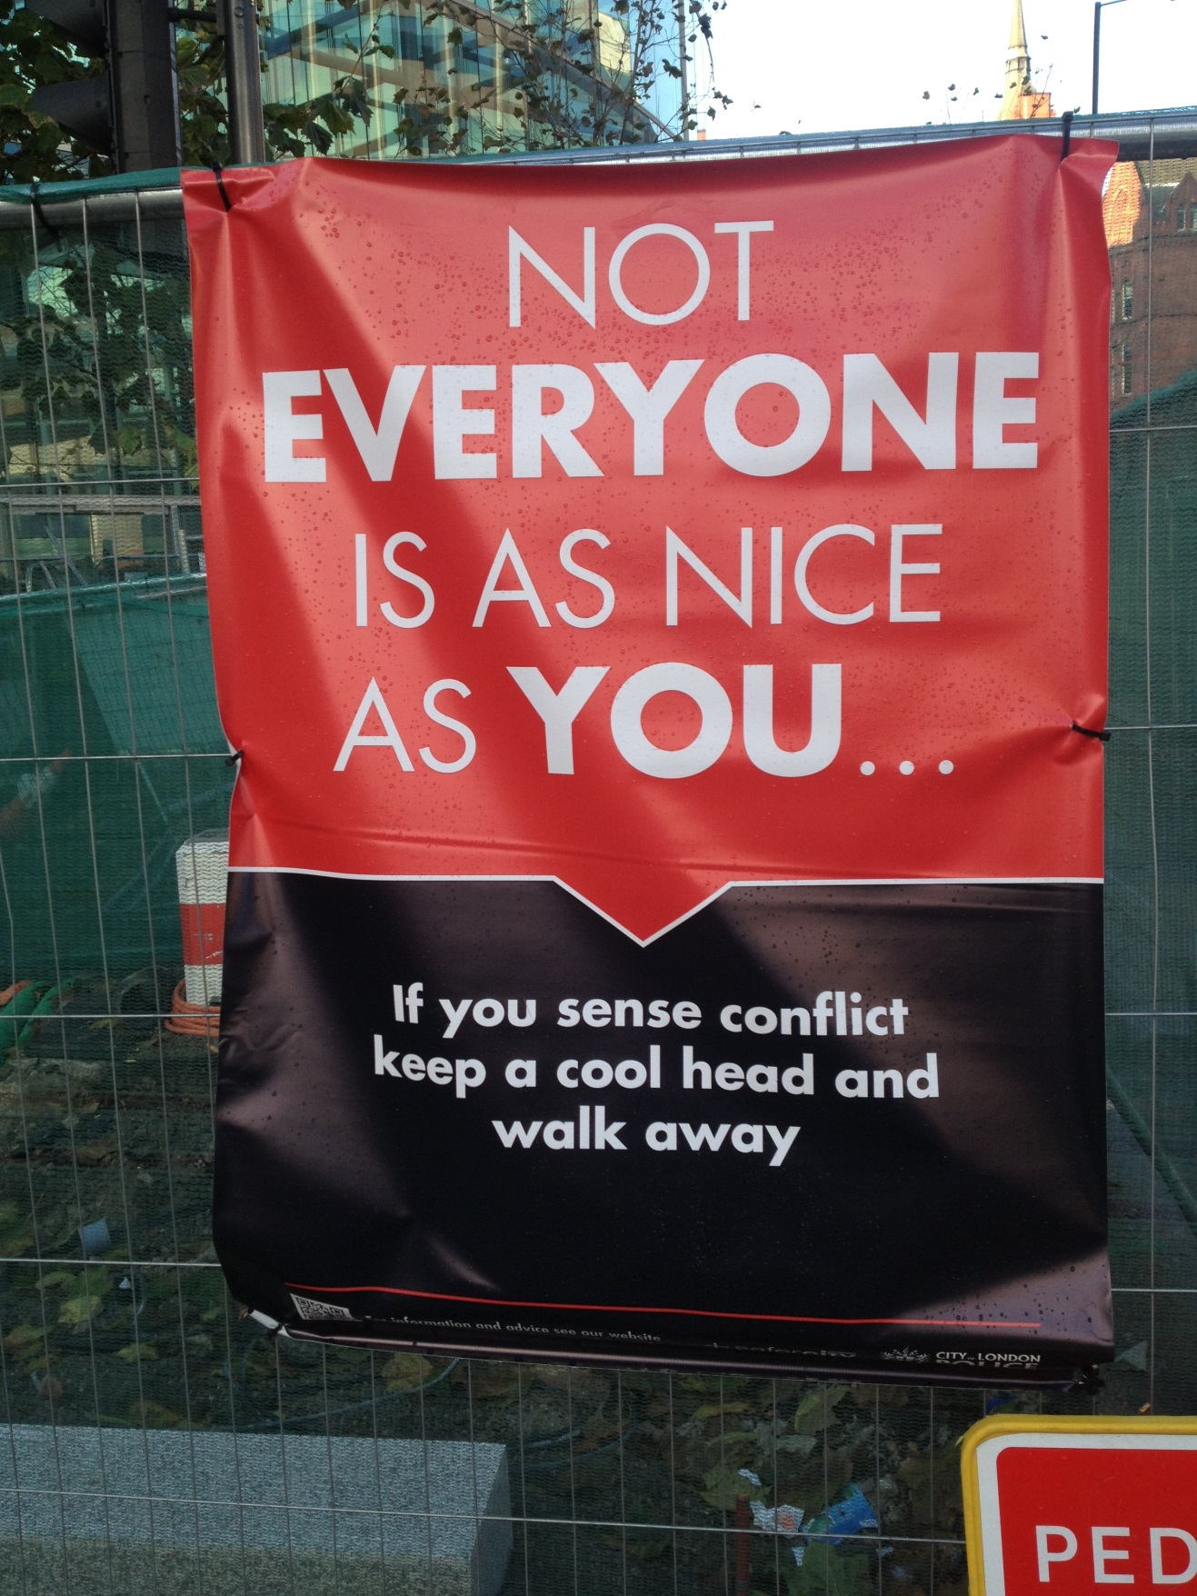

Slide 6
Legal values and skills
Carrie Menkel-Meadow, 2013:
‘In my view, what modern legal education should prepare students for is a set of values and skills that are informed by what “legal” values and law offer to deal with what are essentially human needs.’
Realisation of “justice”;
General “problem-solving” skills.

Slide 7
Problem-solving skills
A sensitivity to:
Fairness
Peace
Decision making
Leadership, facilitation and management
Creativity
Counselling and collaboration
Governance

Slide 8
Professional ethics and legal values
The centrality of professional ethics and legal values to practice across the regulated workforce is one of the clearest conclusions to be drawn from the LETR research data – LETR Exec. Summary, p. xiii
The importance of ethics is signalled, to a high degree, throughout the qualitative data. Professional ethics, and its regulation, are seen as a critical defining feature of professional service. – Report 2.71

Slide 9
The key LETR recommendations
Recommendation 6: LSET schemes should include appropriate learning outcomes in respect of professional ethics, legal research, and the demonstration of a range of written and oral communication skills.
Recommendation 7: The learning outcomes at initial stages of LSET should include reference (as appropriate to the individual practitioner’s role) to an understanding of the relationship between morality and law, the values underpinning the legal system, and the role of lawyers in relation to those values.

Slide 10
Identity apprenticeship
The third apprenticeship, which we call the apprenticeship of identity and purpose, introduces students to the purposes and attitudes that are guided by the values for which the professional community is responsible … it also shares aspects of liberal education in attempting to provide a wide, ethically sensitive perspective … the essential goal … is to teach the skills and inclinations, along with the ethical standards, social roles, and responsibilities … it is the ethical-social apprenticeship through which the student’s professional self can be … explored and developed.
(W Sullivan et al, 2007, 28, quoted in Ferris, 2014,)

Slide 11

There’s no room in the syllabus.

Slide 12
Professional Ethics on a GDL – City Law School
City’s legal ethics course is oriented towards engaging thought-provoking discussion about values, and encourages students to reflect on how their own values will be expressed, tested and developed in legal practice.
(d’Silva, 2013, 92-3)

Slide 13
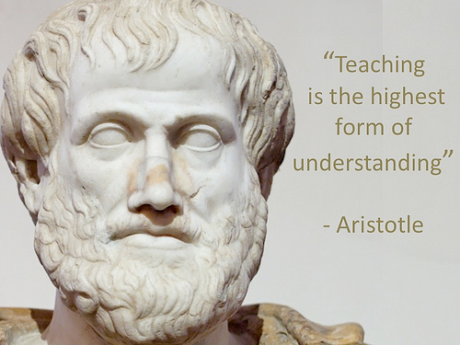
The study of moral philosophy
“Education is not a spectator sport”

Slide 14
Lawyers and virtue
It is one thing if the lawyer has a view of 'proper' virtuous behaviour based upon his own personal capacities and then tries to direct his client to live in accordance with those virtues; it is a different matter if the lawyer seeks to empower the client to identify and live up to the client's own potential for virtuous behaviour. For example ...

Slide 15
Aristotle talks about the importance of finding the mean/virtue/excellence relative to the particular person:
‘By the intermediate in the object I mean that which is equidistant from each of the extremes, which is one and the same for all men; by the intermediate relatively to us that which is neither too much nor too little - and this is not one, nor the same for all. For instance, if ten is many and two is few, six is the intermediate, taken in terms of the object; for it exceeds and is exceeded by an equal amount; this is intermediate according to arithmetical proportion. But the intermediate relatively to us is not to be taken so; if ten pounds are too much for a particular person to eat and two too little, it does not follow that the trainer will order six pounds.’
Aristotle, Aristotle, Nicomachean Ethics (WD Ross trans, Internet Classics Archive, 2005) book 2 ch 6, cited in Email from Dale Dewhurst to Adrian Evans (Evans & King, 2012, 719)

Slide 16
The Affective Domain
So it seems that responding ethically to a situation is not merely a question of knowing the rules, or intending to behave well. To understand it requires consideration of individuals’ emotional responses to the situation in which they find themselves and the question of their exhibiting moral courage and when that might be particularly difficult. Thus, the affective domain is engaged and those of us who are interested in preparing students for ethical practice as lawyers should be willing to address it.
(Duncan, 2012, 257)

Slide 17
An integrative function
One of the problems with language learning is the way it is taught, very linear and strangely scaffolded. I see similar parallels with legal education in how the foundations are taught, seldom with the relational conceptual elements, I once explained to John Flood that I saw the teaching of legal education akin to teaching the human anatomy without explaining the interconnecting relationships - this week the foot, next week the heart and so forth.
(Jon Harman – Basecamp 19/12/13).

Slide 18
The traditional model of legal education
‘Repetitive, incoherent between years and without planned incremental development, and narrowly focused on doctrine rather than skills, theory, values or attitudes …’
(Johnstone 2011, 3)

Slide 19
Students are taught the same type of material – a detailed analysis of common law rules – and are given the same kind of assessment – examinations testing mastery of the legal rules and their application to hypothetical problems – semester after semester, in much the same way … The only thing that changes between subjects and between semesters in the student’s progression through the degree is the substantive rules which forms the content of the subjects.
(Keyes & Johnstone, 2004, 539)

Slide 20
A vertical curriculum
In each vertical subject, students are required:
1. in the early years of the undergraduate program to engage with the basic principles governing its subject matter and skills;
2. in later years to engage with more advanced principles and skills, and the relationship between these principles and skills and other principles and skills;
3. at all stages of the program to use and practice the principles; and
4. at all stages to undertake assessment tasks in relation to the skill and/or subject matter.
(Johnstone , 2011, 17)

Slide 21


Socio-legal studies

Slide 22
Socio-legal studies
“[I]t is principally through empirical study of the practice of law…and in studying the way legal processes and decisions impact upon the citizen, that the disciplines of sociology and, to a lesser degree, philosophy, psychology, and economics have entered into and enriched the study of law. This multidisciplinary research has, in turn, influenced many aspects of legal practice…Even the rules and procedures of the law, which can seem arcane and specialist, reflect this influence.”
Baldwin & Davis, 2003, p. 881, quoted in Genn, Partington & Wheeler, 2006, 1.
See further: Guth & Ashford, 2014.

Slide 23

Student law clinic
Notes:
Armenia

Slide 24
Clinical approaches
Simulated activities
Student law clinic
Placements in advice agencies and law firms
“Clinical method … properly implemented, offers unrivalled opportunities for exploring and examining the ethical dimension of legal practice. The key to this … is the existence of spontaneity or ‘randomness’ in the clinic environment. This provides a rich and realistic learning opportunity for both individual student practice and group discussion that shares their experiences and application of ethical decision-making strategies.”
(Curran, Dickson & Noone, 2005)

Slide 25
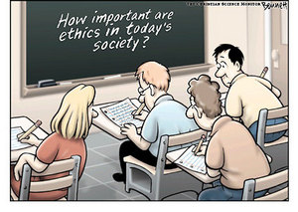
Good academic practice
Awdrey & Sarre, 2013

Slide 26
Legal Practice and Life
“My joy was boundless. I had learnt the true practice of law. I had learnt to find the better side of human nature and to enter men’s hearts. I realized the true function of a lawyer was to unite parties riven asunder. The lesson was so indelibly burnt into me, that a large part of my time during the twenty years of my practice as a lawyer was occupied in bringing about private compromises of hundreds of cases. I lost nothing thereby – not even money, certainly not my soul.”
Mahatma Gandhi, 1927, Part II, ch. 22.

Slide 27
References 1
Rebecca Awdrey & Rick Sarre, 2013, An investigation into plagiarism motivations and prevention techniques: Can they be appropriately aligned? 9, (2) Int J for Educational Integrity, 35-49.
John Baldwin & Gwynn Davis, 2003, Empirical Research in Law, in Peter Cane & Mark Tushnet, The Oxford Handbook of Legal Studies, OUP.
Liz Curran, Judith Dickson & Mary-Anne Noone, 2005, Pushing the boundaries or preserving the status quo? Designing clinical programmes to teach law students a deep understanding of ethical practice, 8 Int. J. Clinical Legal Education, 104.
Nigel Duncan, 2011, Addressing emotions in preparing ethical lawyers in Paul Maharg and Caroline Maughan (eds) Teaching and Reaching the Whole Student – the Impact of Emotions on Learning (and Teaching) the Law, Ashgate.
Adrian Evans & Michael King, 2012, Reflections on the Connections of Virtue Ethics to Therapeutic Jurisprudence, 35, University of New South Wales LJ, 717 – 747.
Magdalene d’Silva, 2013, A new legal ethics education paradigm: culture and values in international arbitration 23(1) Legal Education Review, 83 - 112
Graham Ferris, 2014, Values ethics and legal ethics: The QLD and LETR recommendations 6, 7, 10 and 11, 48 Law Teacher, 20 - 32.
Mohandas Gandhi, 1927, The Story of my Experiments with Truth, Vol 1, Navajivan Trust.

Slide 28
References 2
Hazel Genn, Martin Partington, and Sally Wheeler, Law in the Real World: Improving our Understanding of How Law Works (London, Nuffield Foundation, 2006) http://www.ucl.ac.uk/laws/socio-legal/empirical/docs/inquiry_report.pdf
Jess Guth & Chris Ashford, 2014, LETR: Regulating Socio-Legal and Liberal Legal Education? 48 Law Teacher, 5-19.
John Harman, Basecamp Legal Education Hub, https://basecamp.com.
Richard Johnstone, 2011, Whole-of-Curriculum Design in Law, in Kift, S; Cowley, J; Sanson, M and Watson, P, (eds) ‘Excellence and Innovation in Legal Education’, Lexis Nexis, 2 - 29.
Mary Keyes & Richard Johnstone, 2004, Changing Legal Education: Rhetoric, Reality and Prospects for the Future 26(4) Sydney Law Review 537.
Carrie Menkel-Meadow, 1991 Can a Law Teacher Avoid Teaching Legal Ethics? 41 Journal of Legal Education 3.
Carrie Menkel-Meadow, 2013, Crisis in Legal Education or the Other Things Law Students should be Learning and Doing, 45 McGeorge L Rev 133-160.
William Sullivan, Anne Colby, Judith Welch Wegner, Lloyd Bond, Lee S. Shulman, 2007, Educating Lawyers: Preparation for the Profession of Law, Jossey-Bass.

Slide 29
Contacts
Nigel Duncan: n.j.duncan@city.ac.uk
International Forum on Teaching Legal Ethics and Professionalism: www.teachinglegalethics.org
Teaching Legal Ethics UK – series of free workshops
Next: 22 March 2014, City Law School London
Legal Ethics Forum (in City’s Centre for the Study of Legal Professional Practice)
http://www.city.ac.uk/law/courses/research/centre-for-the-study-of-legal-professional-practice/professional-ethics-forum
6th International Legal Ethics Conference
http://www.city.ac.uk/international-legal-ethics-conference

