Slide 1
Professional Responsibility
& Ethics for
Government Lawyers
Kathleen Clark
John S. Lehmann Research Professor of Law
Washington University in St. Louis
October 2012

Slide 2
Goals

Slide 3
4 Topics
Confidentiality Duty & Privilege
Organization as Client
Whistleblowing by Government Lawyers
Post-Employment

Slide 4
  Theme:
  Professional
  Rules
  Vary
  Across
  States

Slide 5
Bottom Line:
Meet
CLE
Requirements

Slide 6
Confidentiality Duty

Slide 7
Basis for Confidentiality Duty
contracts
statutes / regulations
common law fiduciary duty
professional rules

Slide 8
Common law fiduciary duty
If entrusted with asset / ability to influence
Trusted party must not exploit asset

Slide 9
Professional rules - confidentiality
general duty of confidentiality TX 1.05; MR 1.6
different confidentiality standards MR 1.13
for entity clients
additional fraud-related exception TX 4.01; MR 4.1

Slide 10
Scope scope of confidentiality duty varies by state

Slide 11
Florida Rule 1.6
“information relating to
representation of a client”

Slide 12
Texas Rule 1.05
“privileged information”
or
“unprivileged client information”
relating to or furnished by client
acquired by lawyer during course of or
by reason of representing client

Slide 13
Attorney-Client Privilege

Slide 14
Attorney-Client Privilege
Confidential
Communications
Between a lawyer & client
For the purposes of obtaining legal advice

Slide 15
Attorney-Client Privilege
Protects
information
from
compelled disclosure
in a proceeding

Slide 16
Duty A-C Privilege
Broad scope narrow scope
24/7 Official proceeding
Can L voluntarily Can L be compelled
disclose? to disclose?

Slide 17
Exceptions to Confidentiality
Vary
  Over Time
  State by State

Slide 18
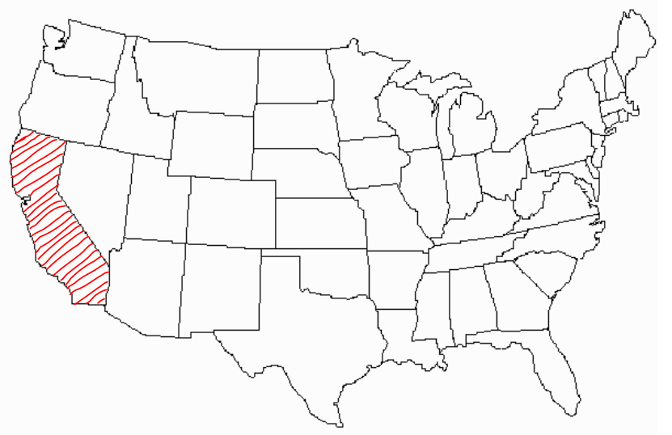
All except California follow ABA Model Rules

Slide 19
Florida Rule 4-1.6
No
specific
exception
for
client
fraud

Slide 20
Florida Rule 4-1.6(b)
Disclosure
required
in
2
circumstances

Slide 21
Florida Rule 4-1.6(b)
to prevent:
(1) client from committing crime
or
(2) death / substantial bodily harm

Slide 22
Florida Rule 4-1.6(c)
Disclosure
permitted
in
5
circumstances

Slide 23
Enron -> change in rules
Enron
Sarbanes Oxley § 307
SEC regulation - 17 C.F.R. § 205
ABA Model Rules revision:
  1.6 – confidentiality
  1.13 – organization as client

Slide 24
Texas Rule 1.05(c)(7) & (8)
permissive exceptions
(7) prevent client crime / fraud
(8) rectify consequences of client crime / fraud – if lawyer’s services were used

Slide 25
Problem Re: Bank Fraud
Florida Rule 4-1.6
Texas Rule 1.05

Slide 26
Problem Re: Bank Fraud
1. May / must you inform the bank?
2. Must you withdraw from representation?
C will re-submit document for additional loan.
3. May / must you inform the bank?

Slide 27
Problem Re: Bank Fraud
Florida Rule 4-1.6
Texas Rule 1.05

Slide 28
Problem Re: Bank Fraud
Florida Rule 4-1.6 --- may not disclose
Texas Rule 1.05

Slide 29
Problem Re: Bank Fraud
Florida Rule 4-1.6 --- may not disclose
Texas Rule 1.05 --- may disclose

Slide 30
Disclosure Option -> Mandate
Texas Rule 1.05 + 4.01(b)
(MR 1.6 + 4.1)

Slide 31
Choice of Law
Model Rule 8.5
McDade Amendment – federal government lawyers

Slide 32
Model Rule 8.5
- tribunal
(2) - where conduct occurs
- where predominant effect of conduct is

Slide 33
McDade Amendment
28 USC § 530B(a)
attorney for the Government
state where attorney engages in duties

Slide 34
The Organization as Client

Slide 35
The Organization as Client
A-C Privilege for Organizations
L’s Special Obligations
A-C Privilege for Government

Slide 36
A-C Privilege
Organizational Clients
Upjohn v. United States - 1981
Garner v. Wolfinbarger - 5th Cir. 1970

Slide 37
Upjohn v. United States – 1981
IRS sought results of internal investigation corporation can assert A-C privilege rejected “control group” test

Slide 38
Garner v. Wolfinbarger - 5th Cir. 1970 derivative action corporate lawyer’s testimony corporation claimed A-C privilege shareholders = beneficiaries fiduciary exception to A-C privilege

Slide 39
Special Obligations To Organizational Clients
Model Rule 1.13
(TX Rule 1.12)

Slide 40
Texas Rule 1.12
If a constituent commits
  violation of
    legal obligation to org.
    law imputed to org.
  likely to result in substantial injury to org.
  related to scope of lawyer’s representation of org.

Slide 41
Texas Rule 1.12
Then lawyer must take “reasonable remedial actions:”
Ask for reconsideration
Suggest separate legal opinion
Refer matter to higher authority within org.

Slide 42
Problem Regarding
Washington Bank & Trust

Slide 43
Maryland (& Model) Rule 1.13
Shall refer matter to higher internal authority
May disclose externally if:
  Highest authority insists on / fails to address
  Clear violation of law
  Reasonably certain to result in
  Substantial injury to organization

Slide 44
Instruction Sheet –
Internal Investigations
Is it
consistent
with
Texas Rule
1.12(e)
?

Slide 45
Texas Rule 1.12(e)
In dealing with an organization's . . . employees, . . .
a lawyer shall explain the identity of the client when it is apparent that the organization's interests are adverse to those of the constituents with whom the lawyer is dealing or when explanation appears reasonably necessary to avoid misunderstanding on their part.

Slide 46
Texas Rule 1.12(e)
In dealing with an organization's . . . employees, . . .
a lawyer shall explain the identity of the client when it is apparent that the organization's interests are adverse to those of the constituents with whom the lawyer is dealing or when explanation appears reasonably necessary to avoid misunderstanding on their part.

Slide 47
Internal Investigation – Instructions
“My name is ______________. As you may be aware, the Inspector General of the ___________ Department is investigating the activities of the Company. We represent the company and are conducting our own review and investigation of this matter. The company has requested that all of its employees cooperate fully and completely in our efforts, and we trust that you will be forthcoming and truthful in your responses. . . .

Slide 48
. . . Although we do not represent you personally, what you tell us today is privileged from disclosure outside the Company. However, the Company determine, in its own discretion, to advise government agencies and investigators or others outside the Company of the results of our work. The decision of whether to disclose this information will be made solely by the Company. If you believe it is necessary, you are free to retain your own lawyer. . . .
Do you understand this?”

Slide 49
A-C Privilege for the Government

Slide 50
A-C Privilege for the Government
Civil Proceedings:
    Litigation
    FOIA
Criminal Proceedings

Slide 51
A-C Privilege for Government in Criminal Proceedings
In re Grand Jury Subpoena Duces Tecum - 8th Cir. 1997
In re Lindsey - D.C. Cir. 1998
In Re: A Witness Before the Special Grand Jury - 7th Cir. 2002
In re: US v. Doe - 2d Cir. 2005

Slide 52
Whistleblowing
Standards for
Government
Lawyers

Slide 53
Problem:
State government lawyer

Slide 54
Problem:
State government lawyer
To whom did Cindy owe a duty of confidentiality?

Slide 55
Identity of the
Government Lawyer’s Client

Slide 56
Identity of the
Government Lawyer’s Client
Public interest?
Public at large
Entire government?
Branch of government?
Agency?
Government official?

Slide 57
Differences between
Public & Private Sector Lawyers
Norms of Openness in Government
Whistleblower Protection for Public / Private Employees

Slide 58
Appropriate
Procedures for
Government
Lawyer
Whistleblowers

Slide 59
Taylor v FDIC - D.C. Cir. 1997
Claimed violation of RTC Whistleblower Act

Slide 60
Substance of Disclosure
Violation of law / regulation
Gross mismanagement

Slide 61
Recipient of Disclosure
Internal
External

Slide 62
Post-Employment
Restrictions for
Government
Lawyers

Slide 63
Seeking future employment
18 USC § 208
“person or organization
with whom
he is
negotiating or has any arrangement concerning
prospective employment”

Slide 64
Post-Employment Restrictions
Model Rule 1.11
(Texas Rule 1.10)
18 USC § 207

Slide 65
Texas Rule 1.10 (Model Rule 1.11)
Trigger:
    “participated personally and substantially as a public officer or employee”
Prohibition:
    Don’t represent a private client in connection with that matter
Imputation of conflict to firm unless lawyer is screened & agency notified

Slide 66
18 U.S.C. § 207
Trigger:
  “participated personally and substantially”
  under official responsibility during last year in govt.
Prohibition:
    Don’t communicate or appear before federal government in connection with that matter
No imputation of conflict

Slide 67
Keep
a list
of
“particular matters
involving specific parties”

Slide 68
Questions?

Slide 69
Professional Responsibility
& Ethics for
Government Lawyers
Kathleen Clark
kathleen_clark@mac.com

