Slide 1
Lessons from Gandhi on Becoming a Lawyer
Transforming Legal Education
Nigerian Law School
8 May 2013
Clark D. Cunningham
W. Lee Burge Professor of Law & Ethics
Georgia State University College of Law
Director, National Institute for Teaching
Ethics & Professionalism (NIFTEP) http://law.gsu.edu/ccunningham/ http://law.gsu.edu/niftep/ www.teachinglegalethics.org
Notes:
ory

Slide 2
The “Carnegie Report”
Educating Lawyers: Preparation for the Profession of Law
  By William M. Sullivan, Anne Colby, Judith Welch Wegner, Lloyd Bond & Lee S. Shulman
  The Carnegie Foundation for the Advancement of Teaching 2007

Slide 3
“Law schools create people who are smart without a purpose.”
Said by a student “from a highly selective private American law school” when interviewed by the Carnegie Foundation

Slide 4
Karl Llewellyn
Said many years ago in a lecture to entering law students
“The hardest job of the first year is to lop off your common sense, to knock your ethics into temporary anesthesia.
It is not easy thus to turn human beings into lawyers.

Slide 5
Karl Llewellyn
Neither is it safe.
For a mere legal machine is a social danger.
Indeed, a mere legal machine is not even a good lawyer.
It lacks insight and judgment.”

Slide 6
Aus: Threshold Learning Outcome 2
The ability to recognise and reflect upon ethical and justice-related issues
  likely to arise in the professional context
An understanding of approaches to ethical decision-making
The developing ability to
  Respond appropriately to ethical and justice-related issues
  Exercise professional judgment

Slide 7
Proposed new standards for US law schools
Revised Standard 302: Learning Outcomes
302(b)(2)(ii): the exercise of professional judgment
consistent with the values of the legal profession
and professional duties to society,
including recognizing and resolving ethical and other professional dilemmas

Slide 8
Four Component Model of Morality (FCM) (Rest, 1983)
Reasons (Predictors)
Faulty Reasoning
Lack of Motivation
Ineffectiveness
Moral
Blindness
Motivation & Identity
Professional Misconduct
Notes:
8

Slide 9
Four Component Model of Morality (FCM)
Moral Capacity (Predictors) | Operational Definition
Moral
Judgment
Capacity to balance competing values and provide justifications for decision
Moral Motivation
Internalized professional identity to motivate action against self-interest
Moral Implementation
Capacity for effective implementation of moral decision
Moral
Sensitivity
Knowledge of standards and capacity to recognize in real-life situations
Motivation & Identity
Effective Professional Conduct
Notes:
9

Slide 10
Cunningham, Remediation Program for Dentists Provides Data on Moral Development
Important to All Professions www.teachinglegalethics.org/content/remediation-program-dentists
Dentists referred for misconduct
14 points lower than dental students on test of moral reasoning (FCM2)
When tested for understanding of “professional responsibilities of a dentist” (FCM3)
  On a scale of 1-12, avg score of 3.8

Slide 11
Carnegie Report
Students need the
The ability to recognize ethical questions even when they are obscured by other issues (FCM1)
Wise judgment when values conflict (FCM2) and
Integrity to keep self-interest from clouding judgment (FCM3)

Slide 12
Carnegie Report
Research shows that higher education can promote the development of more mature moral thinking
Students need to encounter appealing examples of professional ideals
Connected to models of ethical commitment
And then reflect on their own emerging professional identity in relation to those ideals and models

Slide 13
Selected Resources on Forum Website
Cunningham & Alexander, Developing Professional Judgment: Law School Innovations in Response to the Carnegie Foundation's Critique of American Legal Education
www.teachinglegalethics.org/content/developing-professional-judgment
Cunningham, "How Can We Give Up Our Child?" A Practice-Based Approach to Teaching Legal Ethics
www.teachinglegalethics.org/content/practice-based-teaching
Cunningham, How To Explain Confidentiality?
www.teachinglegalethics.org/content/how-explain-confidentiality

Slide 14
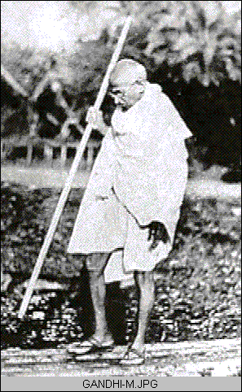

Slide 15
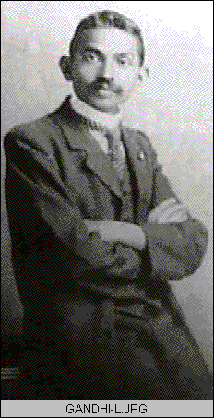

Slide 16
Learning the Law at the Inns of Court
It took me nine months of hard labor to read through the Common Law of England
I passed my examination, was called to the bar, and enrolled in the High Court
  But notwithstanding my study, there was no end to my helplessness and fear
  I did not feel myself qualified to practise law
This was how I began life: I found the barrister’s profession a bad job --
Much show and little knowledge

Slide 17
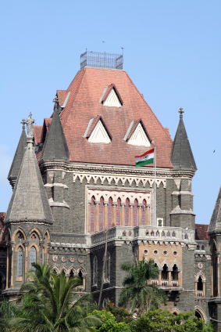
Watching the “Lions” of the Profession
Bombay High Court
I had heard of Sir Pherozeshah Mehta as one who roared like a lion in law courts.
How, could he have learnt the art in England?
I used to attend High Court daily whilst in Bombay,
  but I cannot say that I learnt anything there.
I had not sufficient knowledge to learn much.

Slide 18
Gandhi’s first case – in small causes court
“I appeared for the defendant and had thus to cross-examine the plaintiff's witnesses.
I stood up, but my heart sank into my boots.
My head was reeling and I felt as though the whole court was doing likewise.
I could think of no question to ask.”

Slide 19
I hastened from the court,
  not knowing whether my client won or lost her case
I was ashamed of myself,
and decided not to take up any more cases
until I had courage enough to conduct them.
Indeed I did not go to court again until I went to South Africa.

Slide 20
South Africa - 1893
a most valuable experience of my life
I acquired a true knowledge of legal practice
It was likewise here that I learned
the secret of success as a lawyer.

Slide 21
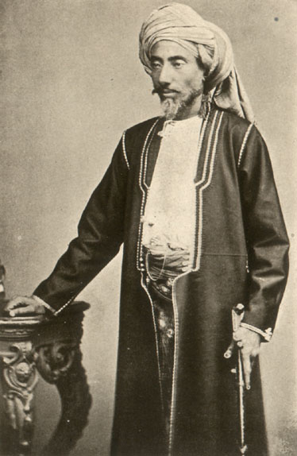
A suspicious client
Abdulla Sheth was practically unlettered
But he had a rich fund of experience
He had an acute intellect
And was conscious of it.
He had one disadvantage
He was by nature suspicious
An Indian Merchant of the 19th Century

Slide 22
A white elephant
He thought his brother had sent him a white elephant.
How far could he trust my ability and honesty?
He would not be in Pretoria to watch me.
The defendants were in Pretoria
And might bring undue influence to bear upon me.

Slide 23
Abdulla Sheth received a letter from his lawyer in Pretoria
Preparations should be made for the case
He should go to Pretoria or send a representative
Abdulla Sheth asked me if I would go

Slide 24
Learning the Client’s Story
“I can only say after I have understood the case from you.”
“At present I am at a loss to know what I have to do there.”
He thereupon asked his clerks to explain the case to me.
I took the keenest interest in the case.
Indeed I threw myself into it.

Slide 25
Concerned about confidentiality
Abdulla Sheth said:
“Should any one of them manage to read our private correspondence,
it might do us much harm.
The more you avoid familiarity with them, the better for us.”

Slide 26
“I should like to be friends”
“Don’t worry.
Not a soul shall know anything that is confidential between us.
But I do intend cultivating the acquaintance of the other party.
I should like to be friends with them. “

Slide 27
“I would try, if possible, to settle the case out of court.
After all Tyeb Sheth is a relative of yours.”
“Y .... es, I see. There would be nothing better than a settlement out of court.”

Slide 28
“But we are all relatives”
“and know one another very well indeed.
Tyeb Sheth is not a man to consent to a settlement easily.
With the slightest unwariness on our part,
he would screw all sorts of things out of us,
and do us down in the end.
So please think twice before you do anything.”

Slide 29
"Don't be anxious about that,"
"I need not talk to Tyeb Sheth, or for that matter to anyone else, about the case.
I would only suggest to him to come to understanding, and so save a lot of unnecessary litigation."

Slide 30
The Train to Pretoria
I began to think
Should I go back to India?
Or should I go on to Pretoria?
It would be cowardice to run back to India without fulfilling my obligation
So I decided to take the next available train to Pretoria

Slide 31
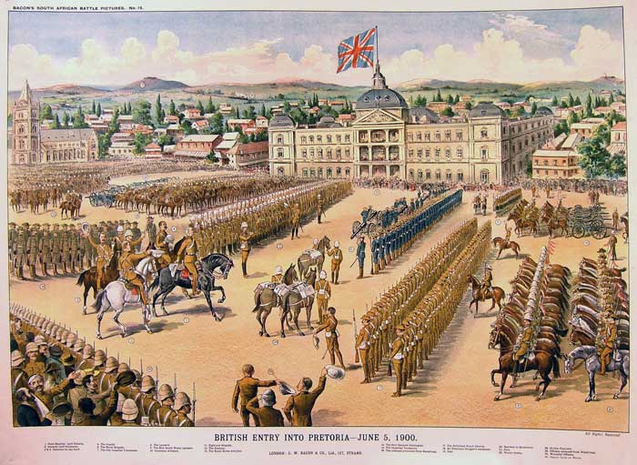
Pretoria

Slide 32
We have no work for you as a barrister
For we have engaged the best counsel.
I shall take your assistance only to the extent of getting necessary information.
And of course you will make communication with my client easy for me,
as I shall now ask for all the information I want from him through you.

Slide 33
“Facts mean truth”
When I was making preparation for Abdulla Sheth's case
I had not fully realized the paramount importance of facts
Facts mean truth,
and once we adhere to truth,
the law comes to our aid naturally.

Slide 34
Facts of the case in context
I saw that the facts of Abdulla Sheth’s case were very strong indeed
But I also saw that the litigation, if it were persisted in,
would ruin the plaintiff and the defendant
who were relatives and both belonged to the same city.

Slide 35
The case was devouring both sides
No one knew how long the case might go on.
Should it be allowed to continue to be fought out in court,
it might go on indefinitely and to no advantage of either party
The lawyer's fees were so rapidly mounting up
that they were enough to devour all the resources of the clients, big merchants as they were.

Slide 36
“I felt it my duty”
The case occupied so much of their attention
that they had no time left for any other work.
In the meantime mutual ill-will was steadily increasing.
This was more than I could bear.
I felt it my duty was to befriend both parties
and bring them together.

Slide 37
Both parties desired an immediate termination of the case, if possible
I approached Tyeb Sheth
I recommended him to see his counsel.
I suggested to him that if an arbitrator commanding the confidence of both parties could be appointed,
the case would be quickly finished.

Slide 38
I strained every nerve to bring about a compromise.
At last Tyeb Sheth agreed.
An arbitrator was appointed, the case was argued before him,
and Dada Abdulla won.

Slide 39
But that did not satisfy me.
If my client were to seek immediate execution of the award,
it would be impossible for Tyeb Sheth to meet the whole of the awarded amount,
and there was an unwritten law among Porbandar Memans living in South Africa
that death should be preferred to bankruptcy.

Slide 40
It was impossible for Tyeb Sheth to pay down the whole sum of about £37,000 and costs.
He meant to pay not a pie less than the amount,
and he did not want to be declared bankrupt.

Slide 41
There was only one way.
Dada Abdulla should allow him to pay moderate installments.
He was equal to the occasion
and granted Tyeb Sheth installments spread over a very long period.

Slide 42
The most difficult thing
It was more difficult for me
to secure this concession of payment by installments
than to get the parties to agree to arbitration.
But both were happy over the result,
and both rose in the public estimation.

Slide 43
My joy was boundless
I had learnt the true practice of law.
I had learnt to find out the better side of human nature
and to enter men’s hearts.
I realized that the true function of a lawyer
was to unite parties riven asunder.

Slide 44
I lost neither money nor my soul
The lesson was so indelibly burnt into me,
that a large part of my time during the twenty years of my practice as a lawyer
was occupied in bringing about private compromises of hundreds of cases.
I lost nothing thereby
– not even money,
certainly not my soul.

