Slide 1
Learning to take a stand through storytelling
Dawn Watkins, Senior Lecturer in Law, University of Leicester. Email dawn.watkins@le.ac.uk
Alison Davies, Author and Professional Storyteller.
Email alrdavies.writer@hotmail.co.uk

Slide 2
A brief history…
‘Storytelling as a tool for Creative Teaching & Learning’ Nov 2008 and Jan 2009
'Exhuming Human Remains from Case Law: The Role of Narrative Research in Legal Education' [2009] 3 Web JCLI
‘Narrative Research Project’ funded by the University of Leicester’s New Teaching Initiatives Fund 2009-11

Slide 3
Findings of the Narrative Research project
“A notable theme in the participants’ accounts is that they had enjoyed participating in the story-telling seminars and reported that this had increased their confidence with public speaking.”
“On this basis it is arguable that seminars of this nature have a ‘stand-alone’ benefit that is worthy of consideration.”
Watkins, D. (2011) ‘The Role of Narratives in Legal Education’ Liverpool Law Review, 32(2), 113-133, at 128

Slide 4
Taking a stand in this workshop
Literally – you will be asked to rewrite the story from the perspective of any character or object in the story
Physically – you will have the opportunity to stand and present your story to the group

Slide 5
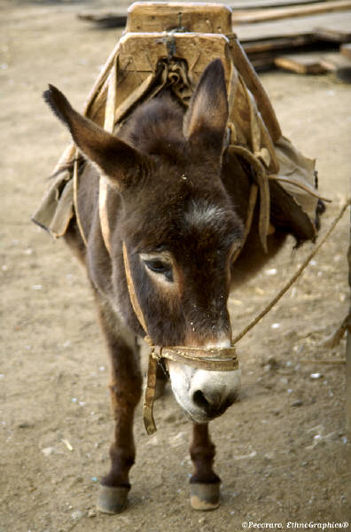
The Story
‘The Miller, His Son and Their Ass’
Aesop’s Fables (Wordsworth Classics, 1994), p.130

Slide 6
Timings
13:45 Introduction and story
13:55 Story writing
14:10 Story telling
14:45 Feedback
15:00 End

