Slide 1
Being a Lawyer, Becoming a Hero Download at: www.teachinglegalethics.org/becoming-hero 7th International Legal Ethics Conference Fordham Law School, New York City July 14, 2016 11am Clark D. Cunningham W. Lee Burge Chair in Law & Ethics Georgia State University College of Law Director, National Institute for Teaching Ethics & Professionalism (NIFTEP) www.ClarkCunningham.org www.niftep.org www.teachinglegalethics.org
Notes:
ory

Slide 2
Carnegie Report
Students need examples of professional ideals
Connected to models of ethical commitment
And then reflect on their own emerging professional identity in relation to those ideals and models

Slide 3
Professional Responsibility: Heroes & Villains
Current course web site:
http://clarkcunningham.org/PR/index.htm
History of the course
How to Explain Confidentiality
www.teachinglegalethics.org/how-explain-confidentiality Search “how to explain”
Learning Professional Responsibility: the Way Forward
www.teachinglegalethics.org/learningpr
Search “way forward”

Slide 4
Four Component Model of Morality (FCM) (Rest, 1983)
Reasons (Predictors)
Faulty Reasoning
Inadequate Motivation
Ineffectiveness
Moral Blindness
Motivation & Identity
Professional Misconduct
Notes:
4

Slide 5
Adapted from Four Component Model of Morality
Moral Capacity (Predictors) | Operational Definition
Mature reasoning
capacity to analyze moral issues and provide justifications for decisions
Commitment
capacity to internalize and give priority to professional values
Skill
capacity for empathic interaction and problem solving
Awareness
capacity to interpret ambiguous clues in real-life settings
Motivation & Identity
Effective Professional Conduct
Notes:
5

Slide 6
Joseph Campbell: The Power of Myth (179)
Star Wars – a very old story in a very new costume
The hero called to adventure
Facing trials and ordeals
Returning with a boon for the community

Slide 7
Being a Lawyer, Becoming a Hero – in progress Chapter introductions at: www.teachinglegalethics.org/becoming-hero
Lt. Commander Charles Swift: Representing Osama bin Laden’s Driver
Suellyn Scarnecchia and the Baby Jessica Case
Kapila Hingorani: Creating a Totally New Jurisprudence for the Disempowered
Sonia Sotomayor: Being a Hero, Becoming a Lawyer
Chief Gani Fawehinmi: Conscience of a Nation
and …

Slide 8
Who is This?
His father was a prominent civil servant
His older brother was a successful lawyer
He wanted to be a doctor but his father and brother persuaded him to be a lawyer
He received the most prestigious legal education that was available
Then observed the leading lawyers of his jurisdiction practice in court

Slide 9
But then came his first case – in small claims court
Notes:
“I appeared for the defendant and had thus to cross-examine the plaintiff's witnesses.
I stood up, but my heart sank into my boots.
My head was reeling and I felt as though the whole court was doing likewise.
I could think of no question to ask.”

Slide 10
I was ashamed of myself,
and decided not to take up any more cases
until I had courage enough to conduct them.”
Notes:
“I hastened from the court,
not knowing whether my client won or lost her case

Slide 11
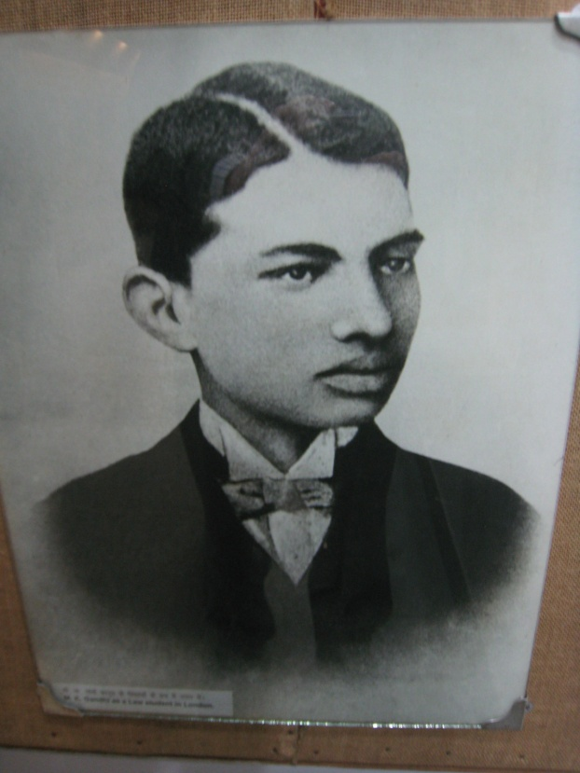
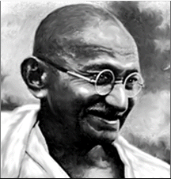

Slide 12
Another client, another chance
He thought his brother had sent him a white elephant.
How far could he trust my ability and honesty?
Notes:
Abdulla Sheth was practically unlettered
But he had a rich fund of experience
He had an acute intellect
And was conscious of it.
He was by nature suspicious

Slide 13
The opportunity to take responsibility
Abdulla Sheth asked me if I would go
Notes:
Abdulla Sheth received a letter from his lawyer in Pretoria
Preparations should be made for the case
He should go to Pretoria or send a representative

Slide 14
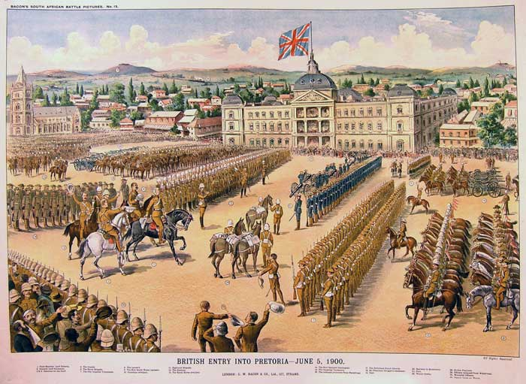
Pretoria

Slide 15
On the cold, dark train platform
“I had gone to South Africa only for a single case prompted by self-interest and curiosity.
I was on the horns of a dilemma.
Notes:
I saw that from the standpoint of self-interest South Africa was no good for me.
Not only did I not desire but I had a positive aversion to earning money or sojourning in a country where I was insulted.

Slide 16
Two courses were open to me.
Or I might bear all hardships, and fulfil my engagement.
Notes:
I might either free myself from the contract with Messrs. Dada Abdulla on the ground that circumstances had come to my knowledge which had not been disclosed to me before, and run back to India.

Slide 17
Sleep was out of the question …
I must accomplish what I had undertaken.
I must reach Pretoria, without minding insults and even assaults.
Notes:
Doubt took possession of my mind.
Late at night, I came to the conclusion that to run back to India would be cowardly.

Slide 18
Pretoria was my goal
but I did not get any sleep
Notes:
The case was being fought out there.
I made up my mind to take some steps, if that was possible, side by side with my work.
This resolution somewhat pacified and strengthened me

Slide 19
The Stage Coach
“He was strong and I was weak.
‘Man, let him alone. Don’t beat him. He is not to blame. He is right.’
Full powerpoint: www.teachinglegalethics.org/lessons-gandhi Search “Gandhi”
Notes:
I clung to the brass rails of the coachbox and was determined to keep my hold even at the risk of breaking my wristbones.
the man swearing at me, dragging and belabouring me, and I remaining still.
Some of the passengers were moved to pity and exclaimed,

Slide 20
Thirteen Years Later
September 11, 1906
“Certificate of registration”
Must present the certificate at all times on penalty of imprisonment
Fingerprinting
Police officers authorized to enter a private home and demand that the woman of the house produce her certificate even if her husband was not present

Slide 21
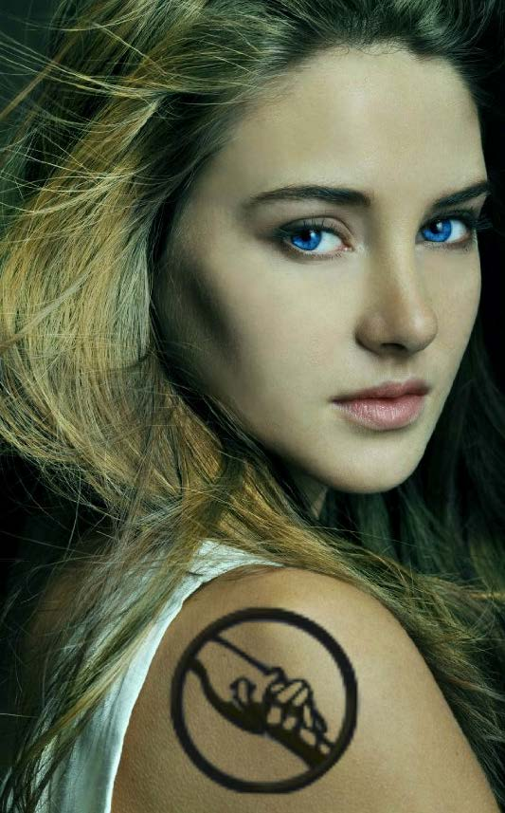
Father: I assume you now regret choosing Dauntless
Tris: “How to be selfless. Often they’re the same thing.”
Tris: “There were some things I needed to learn.”
Her Abnegation father: “How to be brave?”

