Slide 1

The well-being of doing good

Slide 2
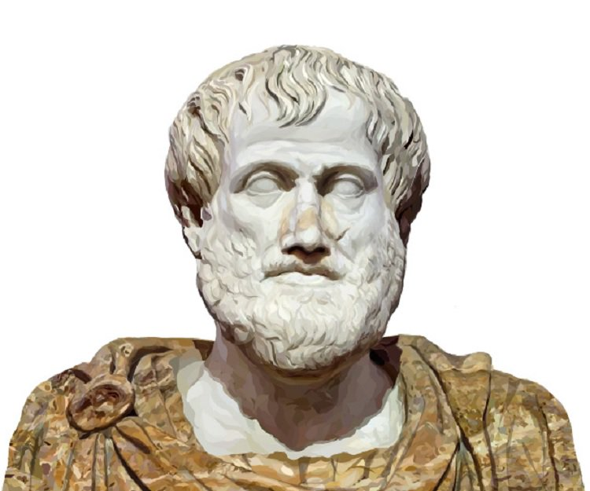
Doing good and well-being
Well-being as ’living well’ or ‘pursuing the right ends’
Notes:
You could argue ‘doing good’ IS well-being

Slide 3

Doing good and well-being
Well-being caused by good actions
Notes:
On the other hand, you could argue doing good LEADS TO well-being. Empirical research with service workers: perceiving one’s actions as having a prosocial impact buffers against burn-out

Slide 4

When are you doing good?
Personal perceived meaning of one’s behavior
Notes:
Empirical studies that show the link between acting on personally perceived meaning and well-being → results my own thesis on how people feel better about engaging in behavior they personally perceive to be more meaningful

Slide 5
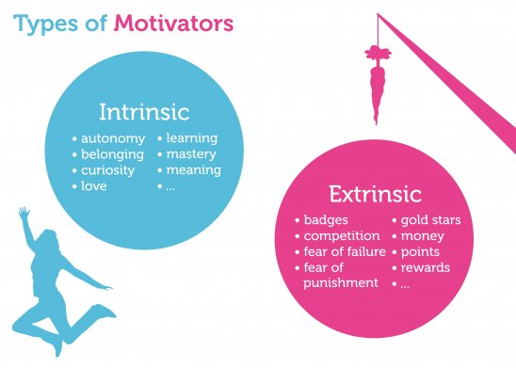
When are you doing good?
Generally meaningful behaviors
Notes:
Studies that show that link between acting on intrinsic values and well-being

Slide 6
Practice of law
Do law practitioners feel they are doing good?
Do they do what they do because they want to do good?
Notes:
Article Krieger & Sheldon – crowding out of intrinsic values and motivation

Slide 7
Law education and doing good
Why do we learn what we learn?
Why do practitioners do what they do?
Emphasis on intrinsic instead of extrinsic values

Slide 8
www.DBGEDRAG.NL
leonie@dbgedrag.nl
https://www.dbgedrag.nl/blog/

