Slide 1


Slide 2
The Interdisciplinary Clinic
Dr Isobel Ryder SFHEA
Program Lead Adult Nursing
Caroline Strevens SFHEA
Reader in Legal Education
Head of School of Law

Slide 3
Interprofessional learning in health
1 in 10 hospital admissions associated with error (Vincent et al 2001, NPSA 2002)
Half of these are avoidable (NPSA 2002, NHS 2013)
Examples where team working compromised people’s safety
  Elaine Bromily
  Medications errors eg administration of Vincristine
  Daniel Pelka
Importance of learning from errors and near misses
Moving towards and open and transparent culture
Traditional IPE involves health and social care

Slide 4
New BN programme
Definition of nursing:
Promotion of health
Prevention of illness
Care of ill, disabled and dying people
Advocacy
Promotion of a safe environment
Research
Participation in shaping health policy
Education (ICN, 2015, WHO 2016)

Slide 5
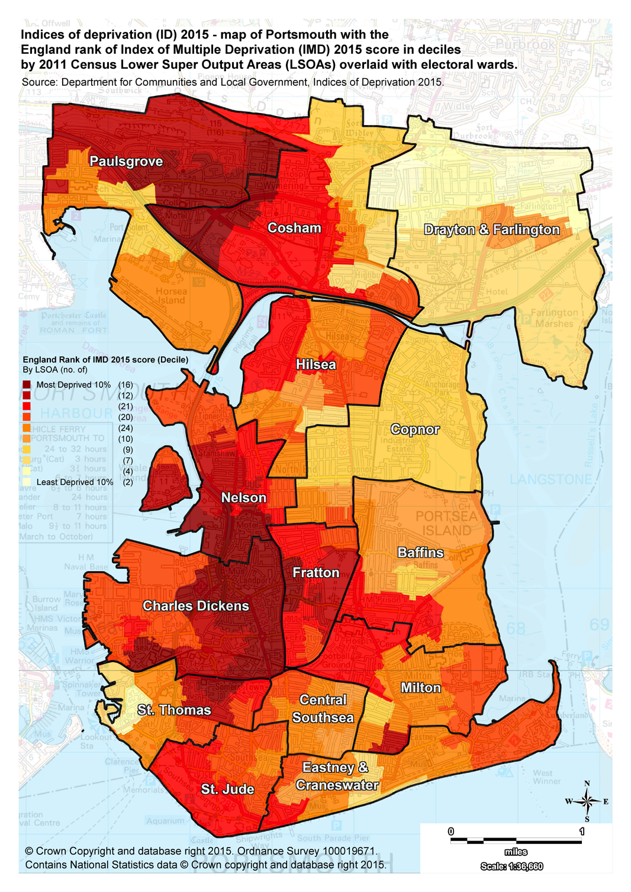
Indices of deprivation (2016)
Notes:
People have multi pathologies:
“In the past, hospitals were designed to deal with acute medical crises, like heart attacks or major accidents. Today, our hospitals also care for people who have multiple, complex conditions and chronic diseases like diabetes. Dealing well with these different health needs means redesigning how we care for people”
The future workforce needs to be based on future work. We should be driving ‘collaborative practice development’ not ‘continuing professional development’ – working across professions, not developing individual professions. Health and social care are team-based activities; the work of one team member is inter-dependent on others (Imison and Bohmer 2015)
mison, C., & Bohmer, R. (2014) NHS and social care workforce: meeting our needs now and in the future? The King’s Fund. Available at: https://www.kingsfund.org.uk/sites/files/kf/field/field_publication_file/perspectives-nhs-social-care-workforce-jul13.pdf (Accessed 9 June 2017).

Slide 6
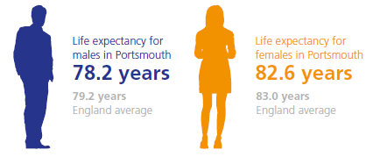
Local Health Inequalities
JSNA Portsmouth 2014

Slide 7
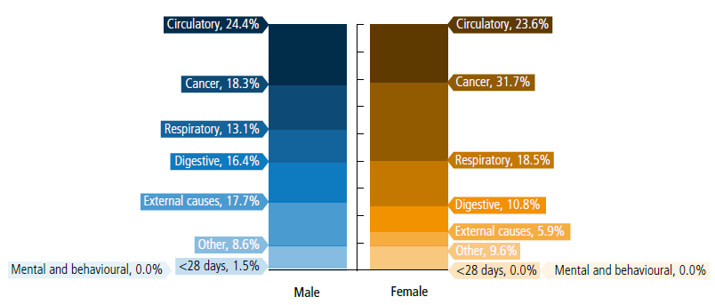
Local Health Inequalities
JSNA Portsmouth 2016

Slide 8
Public and community health
Health is complex and affected by a number of interrelated factors
Health determinants and health inequalities are linked
Public health aims to tackle the causes of poor health rather than just the symptoms (MECC)
Guidance regarding the importance of public health includes the Five Year Forward View and the NHS England Make Every Contact Count Website.
Health inequalities and public health priorities for the community found via useful websites include: Public Health Segment Tool, Child Health Profiles, Public Health Area Outcomes and searching for Joint Strategic Needs Assessment for a specific area.

Slide 9
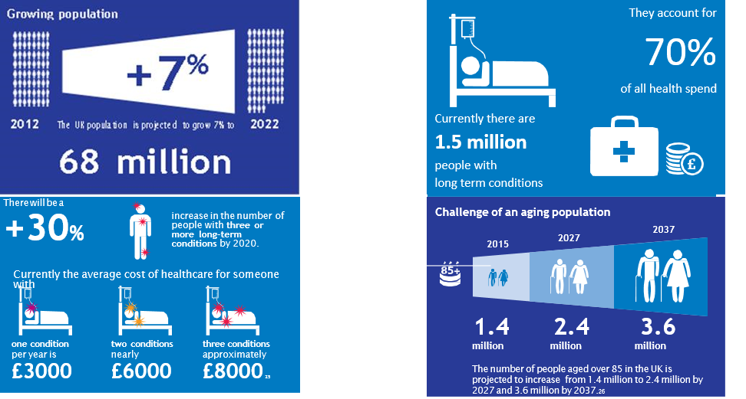
Shape of Caring (2015)

Slide 10

Shape of Caring (2015)
“Healthcare needs to change from an illness-based,provider-led system towards a future vision of one that is patient-led, preventative in focus and offers care based closer to home” (Willis 2015).

Slide 11
Nursing workforce
Reconfiguration of the health system (Darzi Report 2008, Marmot Review 2010, Wanless Report 2014, Shape of Caring 2015), Sustainability and Transformation Plans
Nursing and Midwifery Council draft standards
  Future nurse
  Hospital avoidance
  Community based
Increased emphasis on promotion of health, prevention of illness, self-management
Collaborative practice, team based provision (Imison and Bohmer 2015)
Integration of health and care
Notes:
People have multi pathologies:
“In the past, hospitals were designed to deal with acute medical crises, like heart attacks or major accidents. Today, our hospitals also care for people who have multiple, complex conditions and chronic diseases like diabetes. Dealing well with these different health needs means redesigning how we care for people”
The future workforce needs to be based on future work. We should be driving ‘collaborative practice development’ not ‘continuing professional development’ – working across professions, not developing individual professions. Health and social care are team-based activities; the work of one team member is inter-dependent on others (Imison and Bohmer 2015)
mison, C., & Bohmer, R. (2014) NHS and social care workforce: meeting our needs now and in the future? The King’s Fund. Available at: https://www.kingsfund.org.uk/sites/files/kf/field/field_publication_file/perspectives-nhs-social-care-workforce-jul13.pdf (Accessed 9 June 2017).

Slide 12
Bachelor of Nursing (Adult)
New programme, new provider
Outcomes:
  Demonstrates the right values
  Adopts a person centred approach to nursing
    whole person care (physical health, mental health)
  Able to demonstrate enhanced nursing assessment and coordination of care
  Is resilient, self-reliant and supportive of others
  Demonstrates skills in mentoring/coaching/leadership development
  Ability to work across care setting (integrated care) and teams
  Developed so as to
    influence and improving public health and wellbeing (sustainability)
    encourage and support self-management (sustainability)

Slide 13
Health promotion
Four broad approaches:
Health education
Individual empowerment
Community development/empowerment
Structural adjustment
HP occurs at four levels
primary (prevent ill health, maintain health)
secondary (address health damaging behaviour)
tertiary (HP in those with long term conditions)
quaternary (HP in those with life limiting conditions)
Notes:
670,000 nurses and midwives registered with the NMC (2017)
600,000 nurses are employed in the UK across the NHS, care and private sectors
1 in 10 nursing posts in England are vacant
An ageing workforce, workforce in transition
The NHS deals with over 1 million patients every 36 hours

Slide 14
Bachelor of Nursing (Adult)
Health promotion in the BN curriculum
  Year 1:
    Systematic history taking (general)
    Peer feedback (in simulation)
    Work with Law students in relation to provide educational workshops and information related to local social determinants of health
  Year 2:
    Health behaviours assessment
    Motivational interviewing
    Joint clinic to give individualised public health advice
  Year 3:
    Simulation includes Making Every Contact Count
    Assessment of “readiness to change”
    Health justice clinic in community settings
Notes:
Simulation and placement learning embedded
Under supervisionng embedded in curriculum

Slide 15
Our Vision for the clinic
to break down silo thinking in professional students and build trust in the legal system through exposing health professional and law students to holistic and therapeutic approaches to problem solving, teaching team work, collaboration and breaking down the negative stereotypes of lawyers.
to seek to increase public access to justice and public and professional understanding of law and legal processes, which may impact on health and wellbeing

Slide 16
A three staged approach
The first stage is the provision of public education by Law and health students supervised by qualified and experienced practitioners. At this first stage students will work in community settings to provide educational presentations and workshops but not tailored individualised advice.
The second stage envisages law and health professional students giving legal and public health advice to individuals under close supervision and in accordance with professional standards.
The final stage is the establishment of a health justice clinic staffed by a mixture of professionals, and students on the model of a teaching hospital but on a much smaller scale.

Slide 17
Public Legal Education
One of the goals for the legal clinic is to help clients to help themselves in managing their legal problem
And to address the client and not the legal problem
Local Trading Standards example

Slide 18
Talking about Values
A value is an enduring belief that some goals are preferable to others
Basic psychological needs include autonomy: being free in pursuing choice goals. Feeling true willingness to behave responsibly in accord with own interests and values.
Our small empirical projects appear to link living one’s life according to one’s values makes for higher psychological wellbeing

Slide 19
Intrinsic and Extrinsic motivations
Ryan & Deci (2000)
Intrinsic – doing something because it is inherently enjoyable
Extrinsic – doing something because it leads to a separable outcome
“Intrinsic motivation results in high-quality learning and outcomes” (p55) however it can be undermined.
“because many of the tasks that educators want their students to perform are not inherently interesting or enjoyable, knowing how to promote more active and volitional (versus passive and controlling) forms of extrinsic motivation becomes an essential strategy for successful teaching.” (p55)

Slide 20
Undermining intrinsic motivation
SDT is specifically framed in terms of social and environmental factors that facilitate versus undermine intrinsic motivation.
Cognitive Evaluation Theory (CET Deci & Ryan 1985) argues events such as feedback that conduce feelings of competence during action can increase intrinsic motivation by satisfying the need for competence. (eg optimal challenges and freedom from demeaning evaluation)
However CET also specifies that feelings of competence need to be accompanied by a sense of autonomy ie their behaviour must be self-determined

Slide 21
Undermining intrinsic motivation
The research shows virtually every type of expected tangible reward made contingent on task performance does undermine intrinsic motivation (p59)
Also: threats, deadlines, directives, and competition pressure
Because people experience them as controllers of their behaviour
Choice and the opportunity for self direction enhances

Slide 22
Extrinsic motivation
SDT proposes that extrinsic motivation can vary greatly in the degree to which it is autonomous (p60).
Mere compliance v personal endorsement
SDT describes the problem for teachers as: how do we foster the internalisation and integration of values and behavioural regulations. In lay terms how do we motivate students to value and self regulate educational tasks that are not inherently interesting?

Slide 23
Internalisation
This is the process of taking in a value or regulation.
One’s motivation for behaviour can range from unwillingness to passive compliance to active personal commitment
With greater internalization comes greater persistence, more self perception and better engagement.
Organismic Integration Theory (OIT) explains these different forms of extrinsic motivation and the factors that promote or hinder

Slide 24
Categories of extrinsic motivation
External regulation – performed to satisfy an external demand
Introjected regulation – performed with the feeling of pressure to avoid guilt or anxiety or to satisfy pride
Identification –identified with the personal importance of the behaviour and accepted its regulation as his or her own.
Integrated regulation –fully assimilated through self-examination. It is volitional and valued even though it is valued for an outcome that is separate from the activity itself.

Slide 25
Increased effectiveness and higher wellbeing result from increased internalisation
How do we achieve this? NB not inherently interesting so needs external prompts.
  Valued by significant others (family, peer group of society). SDT – relatedness. Students feel respected and cared for by the teacher.
  Perceived competence –more likely if students understand a goal and have the relevant skills to succeed at it.

Slide 26
Autonomy support
To fully internalize a regulation one must inwardly grasp it meaning and worth.
Autonomy not controlling.
So how shall we do this in our new clinic?
We need to satisfy basic psychological needs in our students and ask them to consciously use these same behaviours with their patients and clients.

Slide 27
Bachelor of Nursing (Adult)
Health promotion in the BN curriculum
  Year 1:
    Systematic history taking (general)
    Peer feedback (in simulation)
    Work with Law students in relation to provide educational workshops and information related to local social determinants of health
  Year 2:
    Health behaviours assessment
    Motivational interviewing
    Joint clinic to give individualised public health advice
  Year 3:
    Simulation includes Making Every Contact Count
    Assessment of “readiness to change”
    Health justice clinic in community settings
Notes:
Simulation and placement learning embedded
Under supervisionng embedded in curriculum

Slide 28
How do we educate our students to motivate their patients / clients?
Curriculum design
  Learning, teaching and assessment strategy
  Use of technology to develop and empower learners
  Simulation embedded in curriculum delivery
  Key themes include:
    Development of mentoring, coaching and leadership skills
    Public health and well-being, health promotion
    Whole person care (the person, not the disease)
    Promoting self-management
      What matters to people?
      What can they control?
    Community focus, keep people out of hospital
Notes:
Values in nursing
People matter
Health is personal
Nursing is about relationships
Seeing people in their context (Hardcastle et al 2015)
The power of motives
Self awareness
Non-judgemental
Knowledge
Confidence (Dixon 2008)
Communication
Empowerment

Slide 29
Relatedness in clinic

Slide 30
Competency in clinic

Slide 31
Autonomy support in clinic

Slide 32

Thank you

