Slide 1

Mainstreaming support for speech and language therapy students
Kirsty Harrison‡
Abigail Levin‡
Marie-Therese Worthington‡
David Glyn†
Midge Seymour-Roots†
Lynne Mark†
‡ Division of Language and Communication Science
† Student Counselling Service, Learning Enhancement and Development

Slide 2
Speakers
Marie-Therese Worthington
Service Manager
Visiting clinical tutor
Kirsty Harrison
Senior Lecturer, School of Health Sciences
Speech and Language Therapist
Notes:
K

Slide 3
Overview
  Background to the project
  Early iterations of the professional development groups
  Educational research aspect
  Outcomes and next steps
Notes:
K

Slide 4
Placements are challenging
Healthcare students face additional pressures including:
  Managing relationship with Practice Educator, peers, clients, family and other MDT members
  Working with people who are sick and/or depressed
  Exposure to safeguarding issues
  Vulnerability to feedback
  Potential placement triggers
  (Birks et al, 2009
Notes:
K

Slide 5
What the research says
Many research studies about stress in healthcare students focuses on nurses and medical students (Saarikoski et al, 2006; Por et al, 2011; Suresh et al, 2013).
The role of placement stress on professional and personal development and how we can best support students in this is not well documented in speech and language therapy
Notes:
K

Slide 6
Our students
Division of Language and Communication Science at City University London
Speech and Language Therapy students:
Postgraduate (2 year programme, 80 students per cohort)
Undergraduate (4 year programme, 40 students per cohort)
Module lead for BSc3 Professional Studies
What led to this educational collaboration
Students struggling with placement challenges (e.g. being observed, receiving feedback, emotional triggers, exposure to distressing situations)
Students reporting it was unprofessional to talk about feelings arising from placements
Students (and lecturers) not having a means for discussing aspects of becoming a professional which did not fit with skills and knowledge
High levels of anxiety amongst student body
Students struggling with what it means to become a professional and what professionalism means
Notes:
Meet clients/situations that remind them of personal experiences
Experience stressful events (e.g. ill health or death of clients)
Many students struggle with the idea of wanting to fix things for people
Students are usually exposed to lots of feedback about their performance (from practice educators; from clinical tutors) and some struggle with this
MT
Observed by practice educators and clinical tutors
Knowledge or confidence in professional roles (e.g. feeding back to parent or teacher)
Over-share or under-share information with Practice Educators
We have a number of students with high anxiety levels

Slide 7
What existing research says
“I think perhaps confidence going into a job is nothing to do with what degree classification you got and is much more to do with the experience you had on your placements”
A newly qualified SLT talking about transitioning from student to practitioner
Brumfitt et al, 2005, p151
Professional identity is inextricably linked to professional competence, which is well defined through minimum standards, and professional confidence, which is harder to understand. Holland et al, 2012
Notes:
MT
Paucity of existing research, however much research in SLT education hints at the idea of there being more to professional education than just skills and knowledge.

Slide 8
What students say
“I found it really really emotional and quite difficult…. Mainly because you don’t get a lot of feedback [from the non-verbal clients]” Alex
“I loved my sessions with him, but it was quite sad…obviously I had to learn all about his history and he’d been in hospital pretty much all his life” Lily
“It was really difficult. A lot of the [parents] got very emotional… even during questionnaires… that was really draining actually , how upset some of them got” Niamh
Read, 2014, pp95, 97 & 98.
Notes:
MT
Students’ thoughts in these quotes particularly lead us to thinking about how we support students to develop emotional resilience with respect to their jobs.

Slide 9
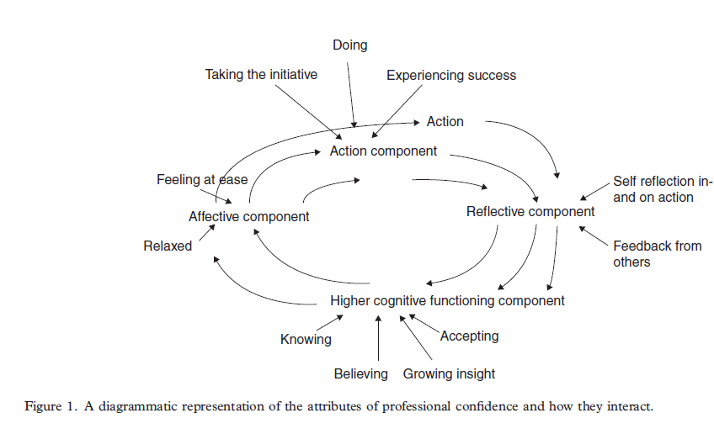
Developing a professional identity
Holland et al, 2012
Notes:
MT

Slide 10
Early professional development groups
Collaborative educational initiative
Trialling professional development groups to support students’ professional and personal development on placements
All students (n=36) invited to 5 groups spanning autumn and spring terms
Additional to clinical tutorials
Attendance is encouraged but not compulsory
Notes:
K
Collaborative initiative between ourselves in SLT and colleagues from the student counselling service in student services
Preceded and succeeded by whole group reflective development groups.

Slide 11
Early professional development groups
Facilitated by two skilled student counsellors/psychotherapists
Focus/topics for discussion are determined by the attendees.
The groups provide a space for students to discuss aspects of placements they find challenging and to explore their responses to these experiences.
Notes:
K

Slide 12
Changes we noticed in the students
Students acknowledging emotional responses to high stress activities, e.g. clinical exam vivas
Understanding the power of silence as a facilitative tool
Positive self-talk
More uptake of additional support
Notes:
K

Slide 13
Educational research
Secured ethical approval to evaluate this project as educational research
Research question
What were undergraduate speech and language therapy students’ perceptions of professional development groups?
Outcomes
Planned:
  Pre- and post-group qualitative anonymous questionnaires
  Focus group to explore students’ experiences in more depth
Actual:
  Low return rate for pre- and post-group questionnaires (n=3)
  Focus group completed (n=5)
Notes:
K
Hope students will have more trust in the process now they have been through the reflective development groups.
Successfully applied for funding to pay for independent researcher to organise, conduct and transcribe focus group to preserve participant anonymity.

Slide 14
Data analysis
Conducted preliminary thematic analysis.
Focus group data will be analysed using Framework (Spencer et al, 2014). Affords thematic analysis between and within cases
Triangulation between researchers, e.g. with indexing and reviewing assignment of data to categories.
Notes:
K
Familiarisation
Constructing initial thematic framework
Indexing and sorting
Reviewing data extracts (in what other ways can the data be sorted and group together? Are there other groupings that are more coherent?)
Data summary and display
Constructing categories
Accounting for patterns - explanation

Slide 15
Challenges
Low engagement with the reflective development groups: approximately 18 students have taken part in the programme over two years.
Suspicion regarding data collection (questionnaires) and how the information would be used.
Notes:
MT

Slide 16
Preliminary themes
Counselling:
  “I think that’s what scared a few people off… because of the word counsellor. Some people thought that it was going to be more counselling and more therapy than it actually was, when it was just based around placement”
  “I’ve had previous counselling and so you either go there thinking, oh, it’s going to be similar, am I going to feel quite emotional? And then you realise it could be less
  emotional, you don’t know where to stop, how much to share”
Notes:
MT

Slide 17
Preliminary themes
Motives:
“So for me, I kind of felt like, “Oh, that’s really nice that they’re actually putting this on and trying to support us” because I know that from feedback with the years above, like a lot of third years did find this year quite challenging and so it was nice to see that feedback kind of in action by putting on something like that.”
“ If something is offered to you... I always like to find out what it is and I’m just sort of that person who will want to go and doesn’t want to miss something”
“That’s what we do with other people. I think it’s interesting to be on the receiving end”

Slide 18
Preliminary themes
Emotional responses:
“I found it quite uncomfortable and I was really trying to like kind of sit in the silence and be like, this is okay. But I realised... people around me, particularly my friend sitting next to me, were finding it really, really tough.”
“It was pretty awkward, but I did feel like it was beneficial because it really helped me to self-analyse why I do what I do, but as a clinician”
What attending says about me:
“people don’t want to think, to come across as they’re having problems, so they don’t want to go to counselling”
Notes:
MT

Slide 19
Next steps
Re-branding groups to reflect existing school model: Personal Professional Development Groups.
Rolling out to all years eventually as part of new programmes.
Starting in year 1 and throughout programme.
Compulsory attendance.
Groups facilitated by LCS staff (clinical and non-clinical pairings).
Regular supervision and training will be provided for group facilitators by trained counsellors.
Notes:
KH

Slide 20
References
Birks Y, McKendree J and Watt I, 2009. ‘Emotional intelligence and perceived stress in healthcare students: a multi-institutional, multi-professional survey’, BMC Medical Education, 9(1), pp61-69.
Brumfitt, S., Enderby, P. & Hoben, K., 2005, ‘ The transition to work of newly qualified speech and language therapists: implications for the curriculum’, Learning in Health and Social Care, 4(2), pp142-155.
Holland, K., Middleton, L., & Uys, L. (2012). Professional confidence: A concept analysis. Scandinavian Journal Of Occupational Therapy, 19(2), 214-224.
Por J, Barriball L, Fitzpatrick J, Roberts J, 2011, ‘Emotional intelligence: it’s relationship to stress, coping, well-being and professional performance in nursing students’, Nurse Education Today, 31, pp855-860.
Read, J. L., 2014. A guide to clinical placements in speech and language therapy. Guildford: J & R Press.
Saarikoski M, Aunio R, Leino-Kilpi H, 2006, Group supervision in facilitating learning and teaching in mental health clinical placements: a case example of one student group, Issues in Mental Health Nursing, 27, 273-285.
Spencer, L., Ritchie, J., Ormston, R., O’Connor, W. and Barnard, M., 2014, ‘Analysis: principles and processes’, in Ritchie, J., Lewis, J., McNaughton Nicholls, C. and Ormston, C. (Eds.), 2014, Qualitative research practice: a guide for social science students and researchers, Sage: London.
Suresh P, Matthews A, Coyne I, 2013, ‘Stress and stressors in the clinical environment a comparative study of fourth-year student nurses and newly qualified general nurses in Ireland Stress and stressors in the clinical environment’, Journal of Clinical Nursing, 22(5-6), pp770-779.

Slide 21
Questions?

Slide 22
City, University of London
Northampton Square
London
EC1V 0HB
United Kingdom
T: +44 (0)20 7040 8292
E: Kirsty.Harrison.1@city.ac.uk
www.city.ac.uk/health

